Slide 1
Module: 2 Random Variables
Introduction -random variables- probability mass Function, distribution and density functions - joint Probability distribution and joint density functions- Marginal, conditional distribution and density functions- Mathematical expectation, and its properties Covariance, moment generating function – characteristic function.

Slide 2
Random experiment: It is a process or procedure that produces a set of outcomes, where the outcome is uncertain and cannot be predicted with certainty in advance. Example: Throwing a die, a pack of cards.
Outcome: The result of a random experiment will be called an outcome.
Trial: A trial refers to any single performance of a random experiment. In each trial, one of the possible outcomes occurs. Example: Tossing of a coin: {H, T}
Event: An event is a specific set of outcomes of a random experiment. An event can consist of one or more outcomes. Events are often what we are interested in when conducting an experiment.
Exhaustive events or cases: The complete set of all possible outcomes in a random experiment. In other words, these events cover every possible outcome that could occur in a trial.
Favourable events or cases: The number of cases favourable to an event in a trail is the number of outcomes which entail the happening of the event.
Example: In drawing a card from a pack of cards the number of cases favourable to drawing of an ace is 4, for drawing a spade card is 13 and for drawing a red card is 26.

Slide 3
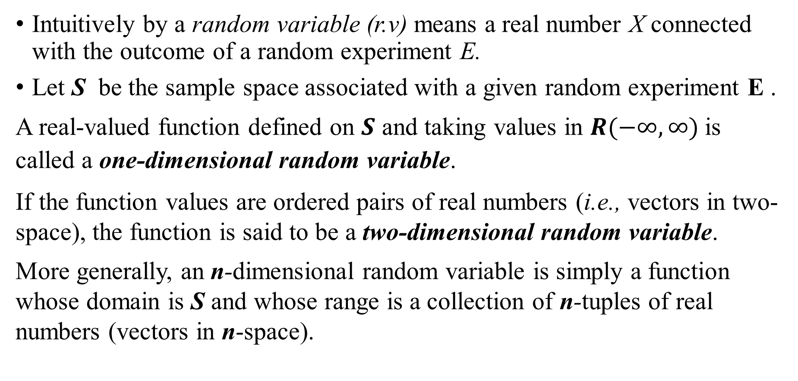
Random Variable
Intuitively by a random variable (r.v) means a real number X connected with the outcome of a random experiment E.
Let S be the sample space associated with a given random experiment E .
A real-valued function defined on $S$ and taking values in $R(−∞,∞)$is called a one-dimensional random variable.
If the function values are ordered pairs of real numbers (i.e., vectors in two-space), the function is said to be a two-dimensional random variable.
More generally, an n-dimensional random variable is simply a function whose domain is S and whose range is a collection of n-tuples of real numbers (vectors in n-space).

Slide 4
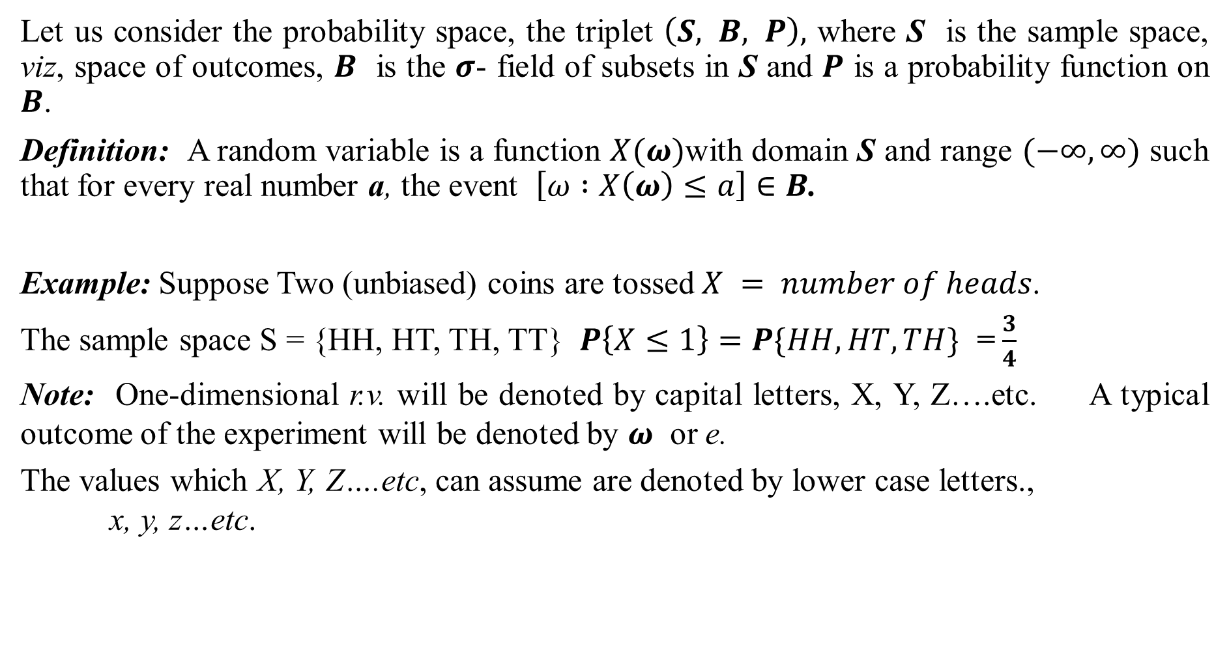
Let us consider the probability space, the triplet $\left(S, Β, Ρ\right),$ where S is the sample space, viz, space of outcomes, $Β$ is the $σ$- field of subsets in S and $Ρ$ is a probability function on $Β$.
Definition: A random variable is a function $X(ω)$with domain S and range $(−∞,∞)$ such that for every real number a, the event $\left[ω :X\left(ω\right)≤a\right]∈Β$.
Example: Suppose Two (unbiased) coins are tossed $X = number of heads$.
The sample space S = {HH, HT, TH, TT} $P\left\{X≤1\right\}=P\{HH,HT,TH\}$ = $\frac{3}{4}$
Note: One-dimensional r.v. will be denoted by capital letters, X, Y, Z….etc. A typical outcome of the experiment will be denoted by $ω$ or e.
The values which X, Y, Z….etc, can assume are denoted by lower case letters.,
x, y, z…etc.

Slide 5
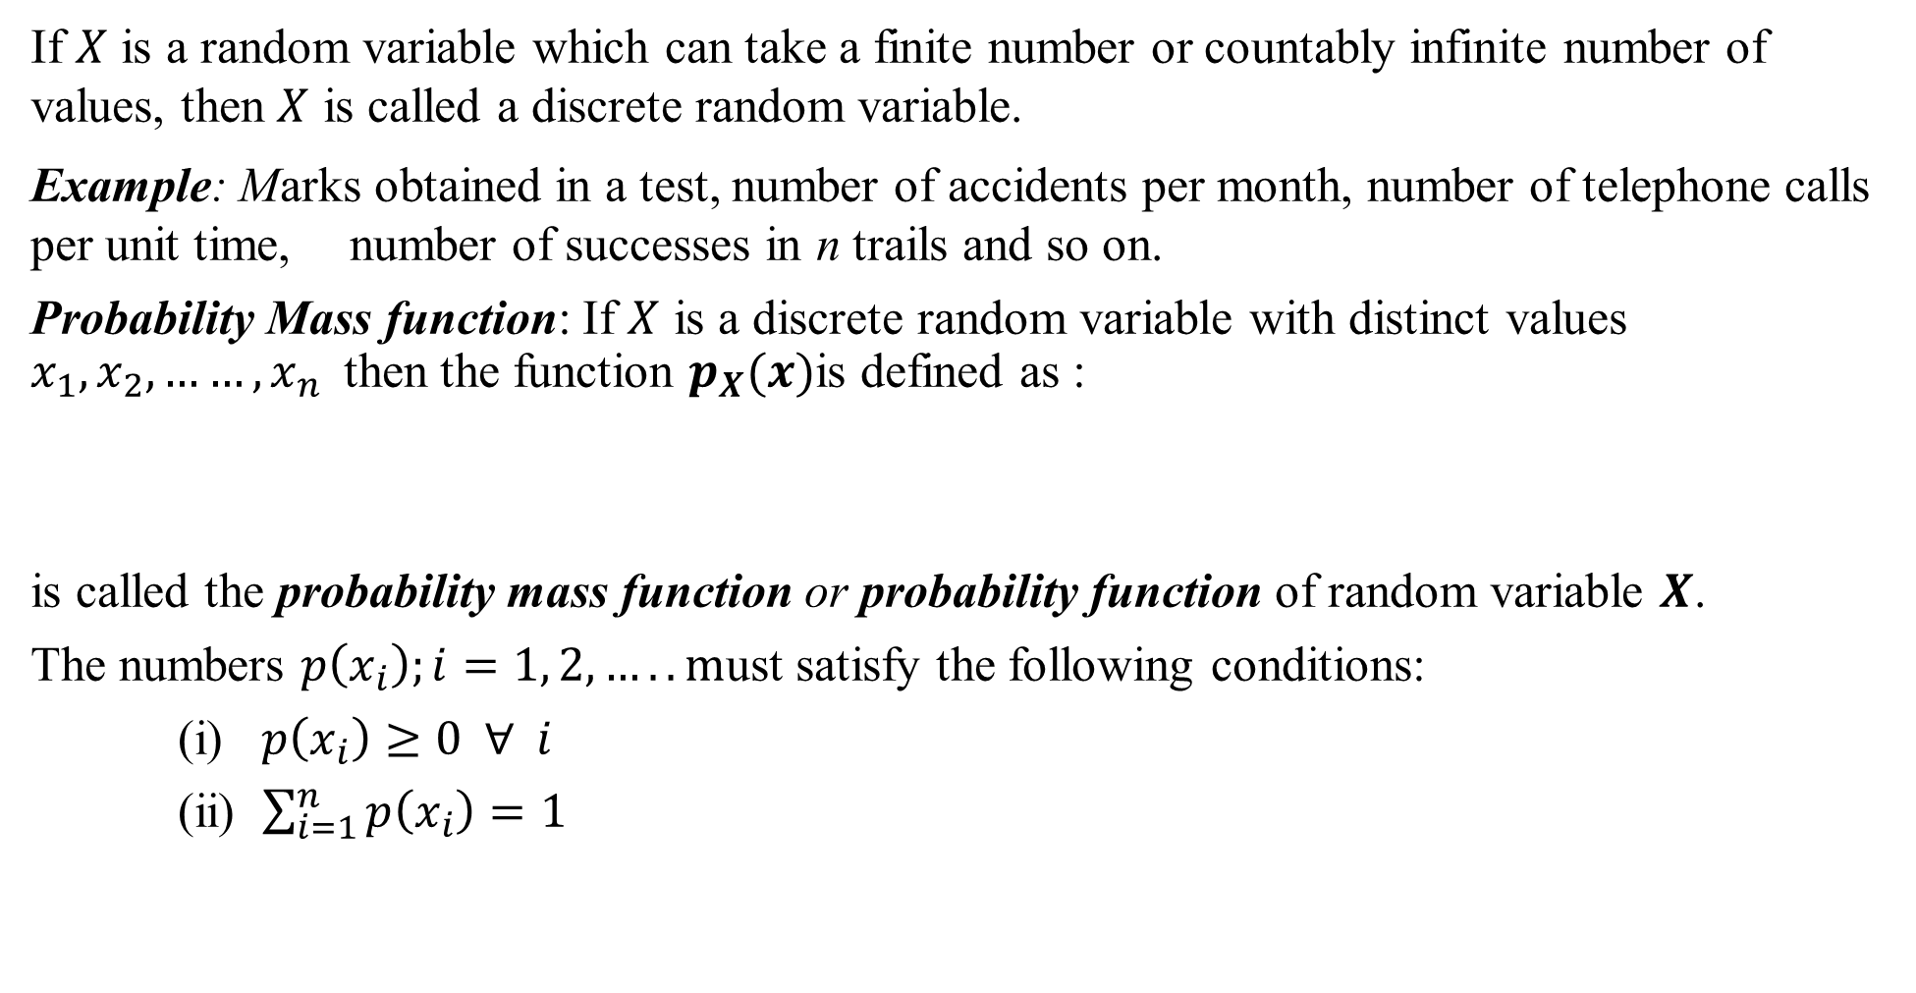
Discrete Random Variable
If $X$ is a random variable which can take a finite number or countably infinite number of values, then $X$ is called a discrete random variable.
Example: Marks obtained in a test, number of accidents per month, number of telephone calls per unit time, number of successes in n trails and so on.
Probability Mass function: If $X$ is a discrete random variable with distinct values $x_{1}, x_{2}, ……,x_{n}$then the function $p_{X}(x)$is defined as :
is called the probability mass function or probability function of random variable $X$.
The numbers $p\left(x_{i}\right);i=1, 2, ….. m$ust satisfy the following conditions:
(i) $p\left(x_{i}\right)≥0 ∀ i$
(ii) $\sum_{i=1}^{n}{p\left(x_{i}\right)=1}$

Slide 6
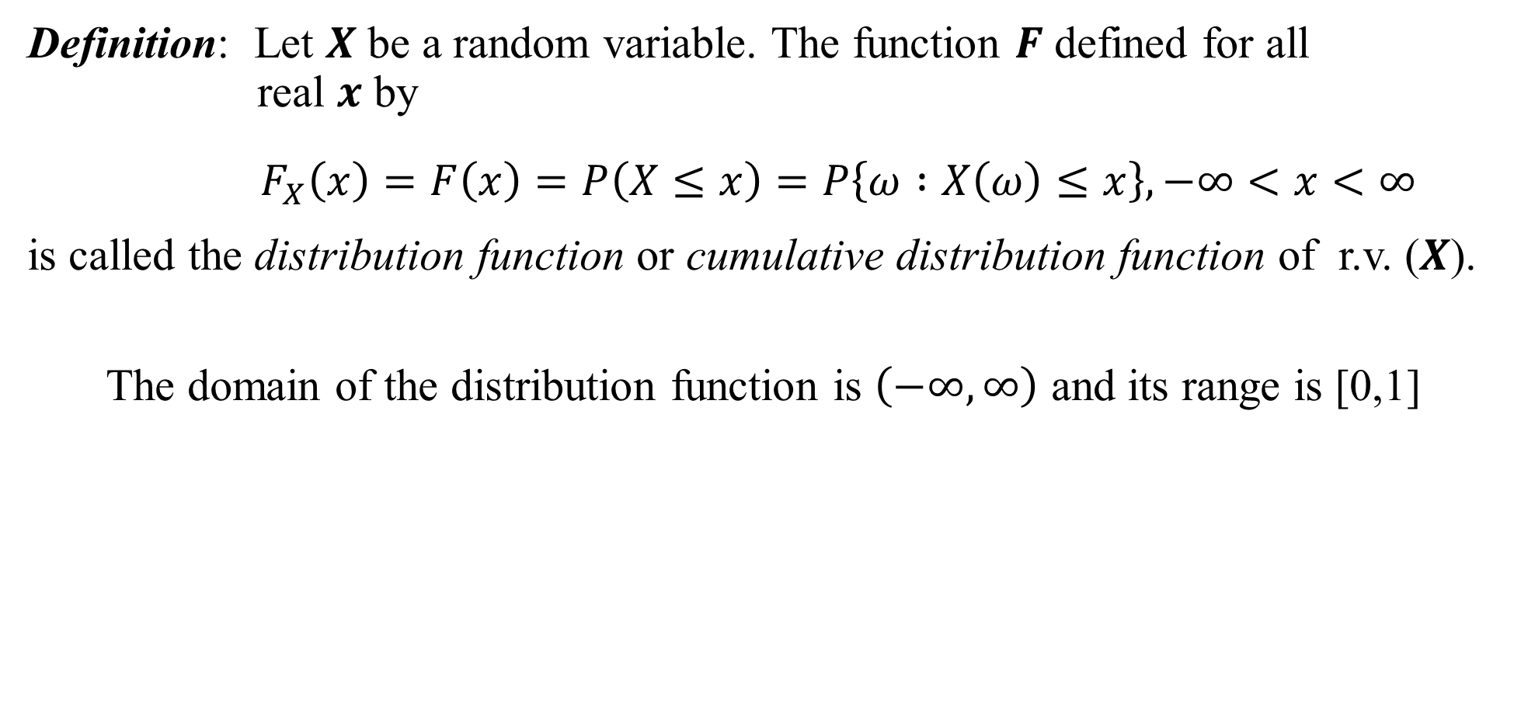
Distribution Function
Definition: Let $X$ be a random variable. The function $F$ defined for all real $x$ by
$$F_{X}\left(x\right)=F\left(x\right)=P\left(X≤x\right)=P\left\{ω :X\left(ω\right)≤x\right\}, −∞<x<∞$$
is called the distribution function or cumulative distribution function of r.v. ($X$).
The domain of the distribution function is $\left(−∞, ∞\right)$ and its range is [0,1]

Slide 7
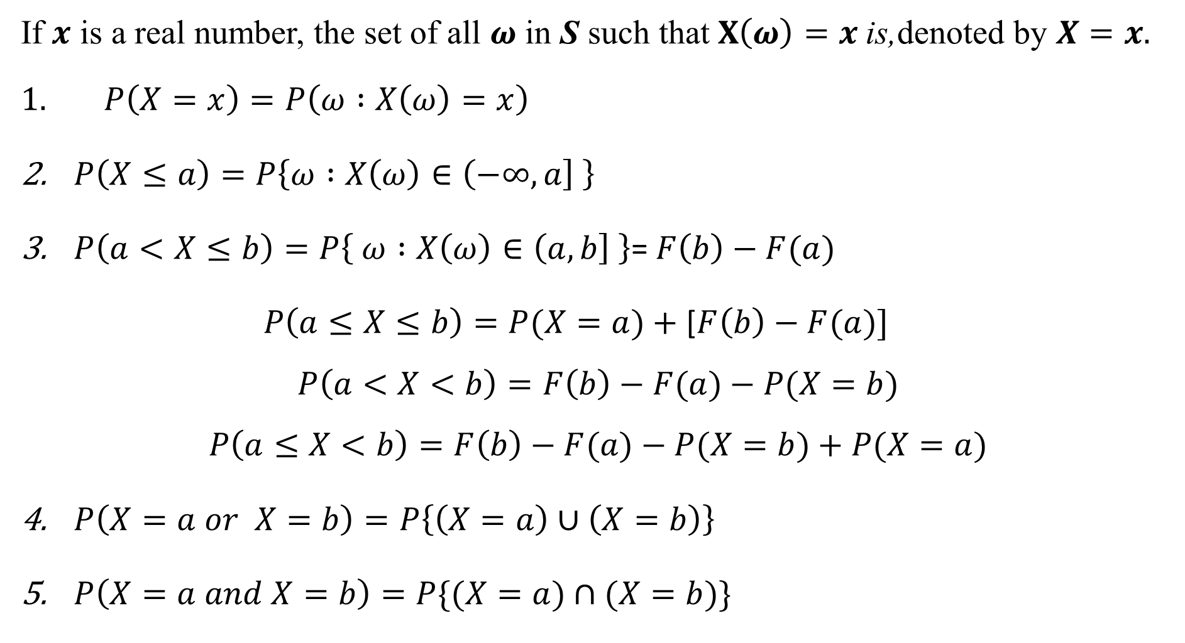
Properties:
If $x$ is a real number, the set of all $ω$ in S such that $X\left(ω\right)=x$is,denoted by $X=x.$
$P\left(X=x\right)=P\left(ω :X\left(ω\right)=x\right)$
$P\left(X≤a\right)=P\left\{ω :X\left(ω\right)∈\left(−∞, a\right] \right\}$
$P\left(a<X≤b\right)=P\left\{ ω :X\left(ω\right)∈\left(a, b\right] \right\}$= $F\left(b\right)−F(a)$
$P\left(a≤X≤b\right)=P(X=a)+$ [$F\left(b\right)−F(a)]$
$$P\left(a<X<b\right)=F\left(b\right)−F(a)−P(X=b)$$
$$P\left(a≤X<b\right)=F\left(b\right)−F(a)−P(X=b)+P(X=a)$$
$P\left(X=a or X=b\right)=P\left\{\left(X=a\right)∪\left(X=b\right)\right\}$
$P\left(X=a and X=b\right)=P\{(X=a)∩(X=b)\}$

Slide 8

Properties
If $F$ is the distribution function of the r.v. $X$ and if $a<b$, then
6.$P\left(a<X≤b\right)=P\left(X≤b\right)−P\left(X≤a\right)=F\left(b\right)−F\left(a\right)$
7. (i) $0≤F\left(x\right)≤1$
(ii) $F\left(x\right)≤F\left(y\right)$ if $x<y$
8. $F\left(−∞\right)=\lim_{x→−∞}{F\left(x\right)=0}$ and
$$F\left(∞\right)=\lim_{x→∞}{F\left(x\right)=1}$$

Slide 9
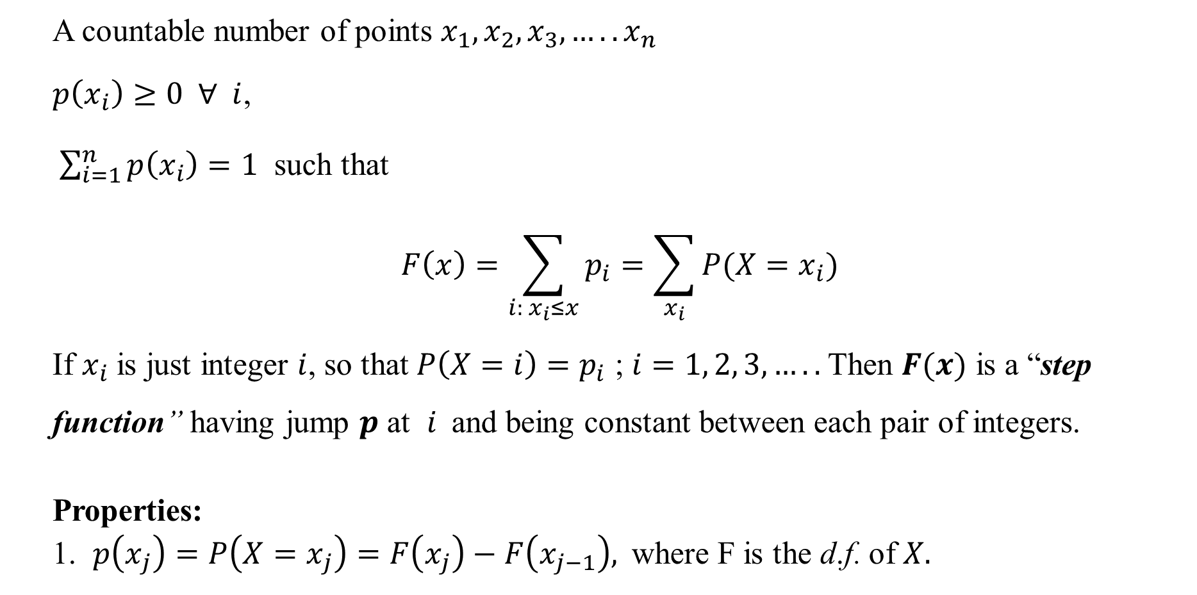
Discrete Distribution Function:
A countable number of points $x_{1},x_{2},x_{3},…..x_{n}$
$p\left(x_{i}\right)≥0 ∀ i$,
$\sum_{i=1}^{n}{p\left(x_{i}\right)=1}$ such that
$$F\left(x\right)=\sum_{i: x_{i}≤x}{p_{i}}=\sum_{x_{i}}{P(X=x_{i})}$$
If $x_{i}$ is just integer $i$, so that $P\left(X=i\right)=p_{i}$ ; $i=1, 2, 3,…..$Then $F(x)$ is a “step function” having jump $p$ at $i$and being constant between each pair of integers.
Properties:
1. $p\left(x_{j}\right)=P\left(X=x_{j}\right)=F\left(x_{j}\right)−F\left(x_{j−1}\right),$where F is the d.f. of $X.$

Slide 10
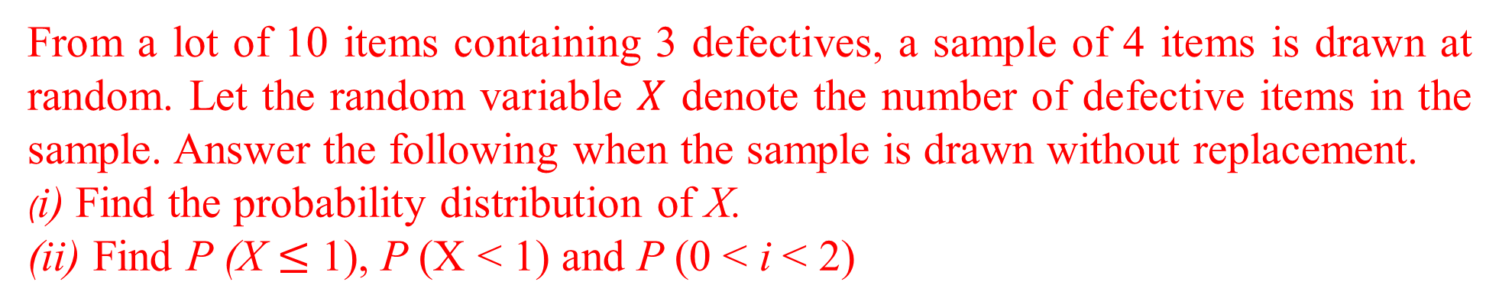
From a lot of 10 items containing 3 defectives, a sample of 4 items is drawn at random. Let the random variable $X$ denote the number of defective items in the sample. Answer the following when the sample is drawn without replacement.
(i) Find the probability distribution of X.
(ii) Find P (X $≤$ 1), P (X < 1) and P (0 < i < 2)

Slide 11
i)
ii)

Slide 12
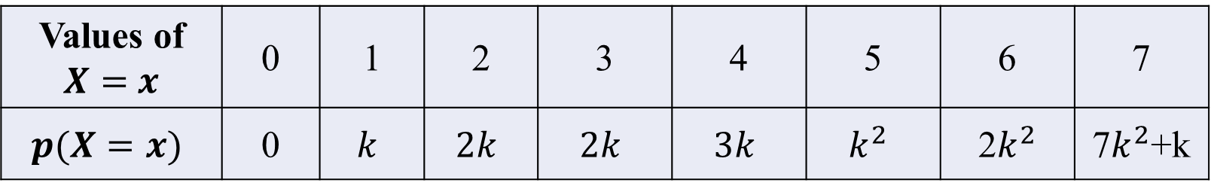
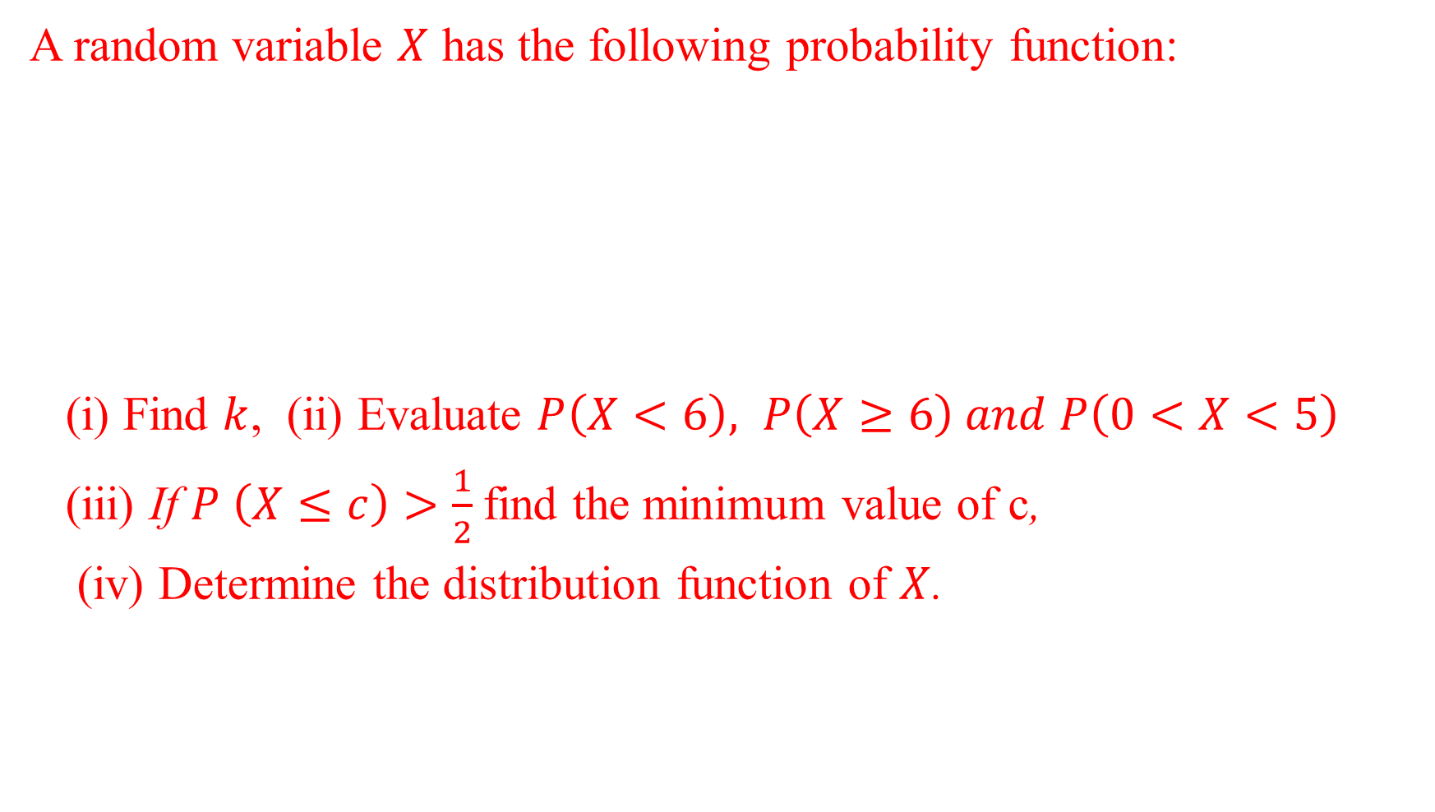
A random variable $X$ has the following probability function:
(i) Find $k$, (ii) Evaluate $P\left(X<6\right), P\left(X≥6\right) and P\left(0<X<5\right)$
(iii) If $P \left(X≤c\right)>\frac{1}{2}$find the minimum value of c,
(iv) Determine the distribution function of $X$.
Values of $X=$ $x$ | 0 | 1 | 2 | 3 | 4 | 5 | 6 | 7
$$p(X=x)$$ | 0 | $$k$$ | $$2k$$ | $$2k$$ | $$3k$$ | $$k^{2}$$ | 2$k^{2}$ | 7$k^{2}$+k

Slide 13
Solution :

Slide 14
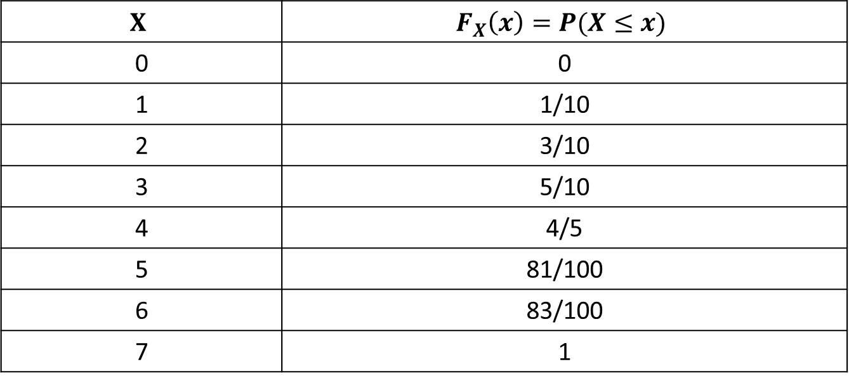
$$X$$ | $$F_{X}\left(x\right)=P(X≤x)$$
0 | 0
1 | 1/10
2 | 3/10
3 | 5/10
4 | 4/5
5 | 81/100
6 | 83/100
7 | 1
iv)

Slide 15
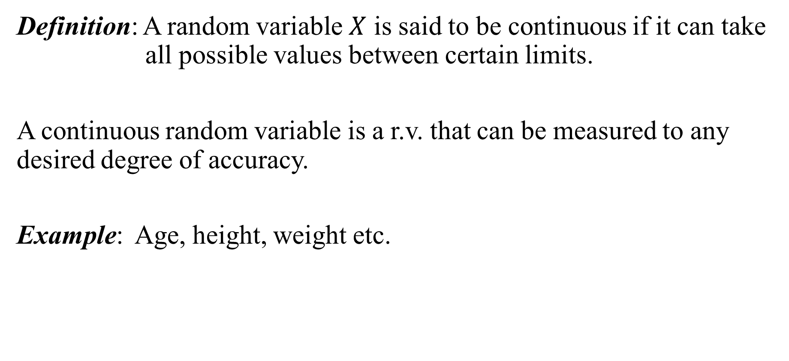
Continuous Random Variable
Definition: A random variable $X$ is said to be continuous if it can take all possible values between certain limits.
A continuous random variable is a r.v. that can be measured to any desired degree of accuracy.
Example: Age, height, weight etc.

Slide 16
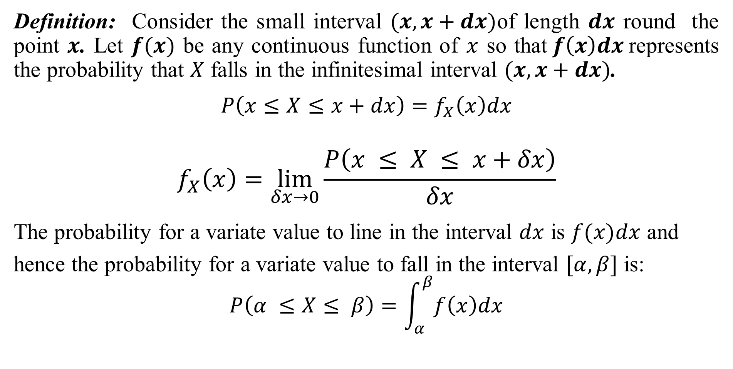
Probability Density Function (p.d.f)
Definition: Consider the small interval $(x, x+dx)$of length $dx$ round the point $x$. Let $f(x)$ be any continuous function of $x$ so that$f\left(x\right)dx$represents the probability that $X$ falls in the infinitesimal interval $(x, x+dx)$.
$$P\left(x≤X≤x+dx\right)=f_{X}\left(x\right)dx$$
$$f_{X}\left(x\right)=\lim_{δx→0}{\frac{P\left(x ≤ X ≤ x+δx\right)}{δx}}$$
The probability for a variate value to line in the interval $dx$ is $f(x)dx$ and
hence the probability for a variate value to fall in the interval $[α, β]$ is:
$$P\left(α ≤X≤ β\right)=\int_{α}^{β}{f\left(x\right)dx}$$

Slide 17

Continuous Distribution Function
Definition: If $X$ is continuous r.v. with the p.d.f.$f(x)$, then the function
$F_{X}\left(x\right)=P\left(X≤x\right)=\int_{−∞}^{x}{ f\left(t\right) dt}$ ; $−∞<x<∞$ is called the distribution function (d.f.) or sometimes the cumulative distribution function (c.d.f.) of the random variable $X.$

Slide 18
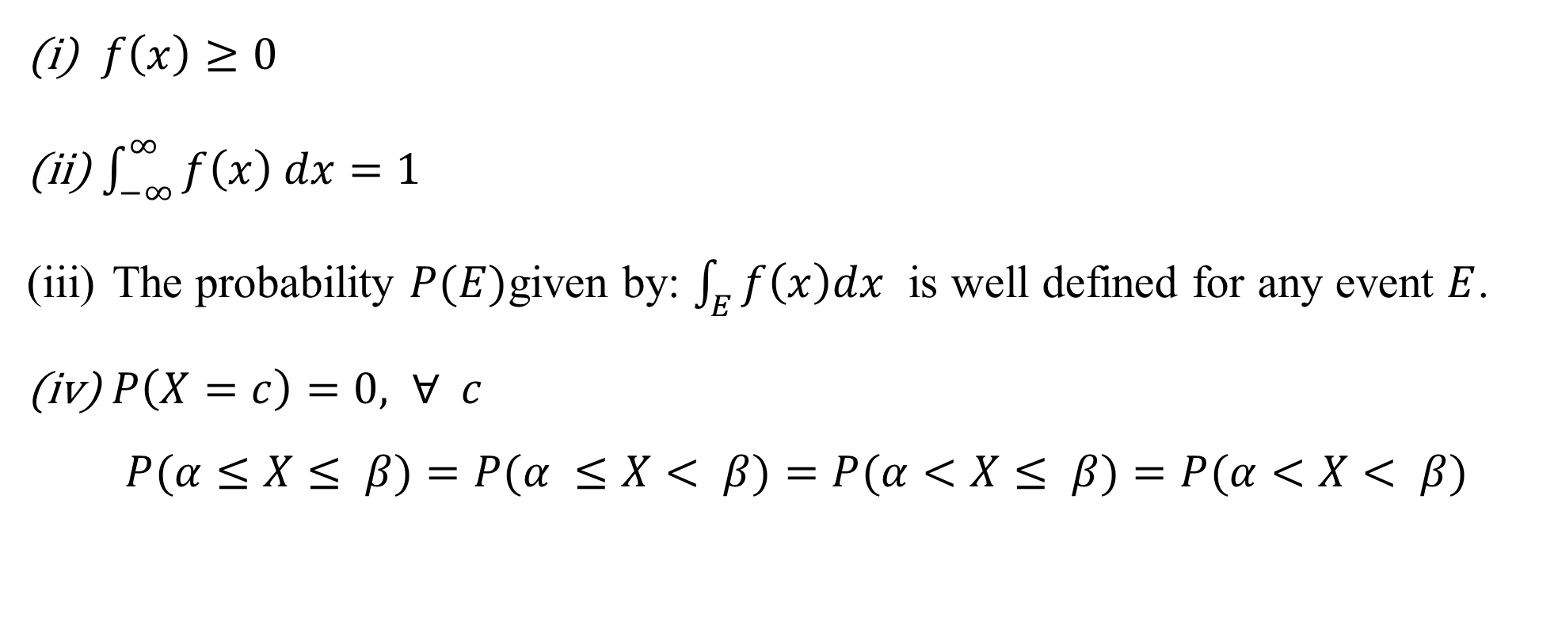

Properties of $p.d.f.$ :
$f\left(x\right)≥0$
$\int_{−∞}^{∞}{f\left(x\right) dx}=1$
The probability $P(E)$given by: $\int_{E}{f\left(x\right)dx}$ is well defined for any event $E$.
$P\left(X=c\right)=0, ∀ c$
$$P(α≤X≤ β)=P(α ≤X< β)=P(α<X≤ β)=P(α<X< β)$$

Slide 19
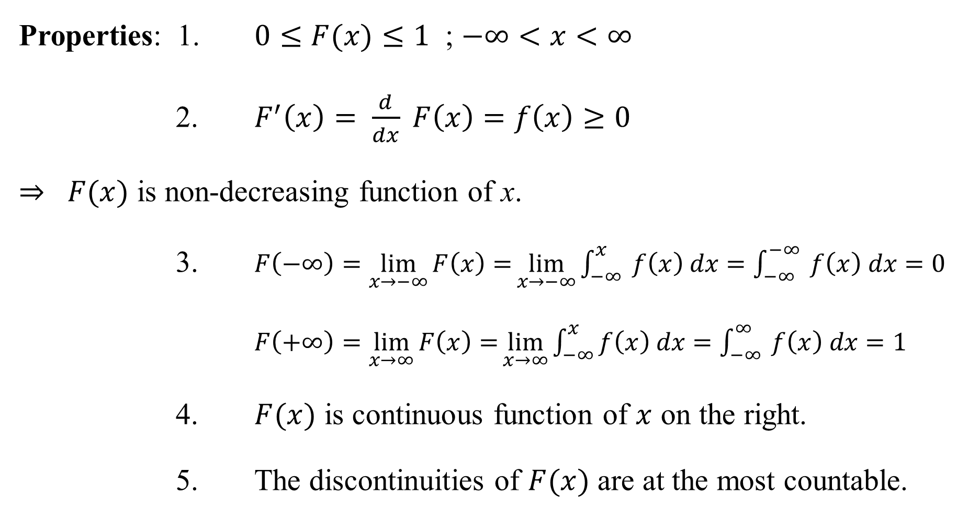
Properties: 1. $0≤F(x)≤1$ ; $−∞<x<∞$
2. $F^{′}\left(x\right)= \frac{d}{dx} F\left(x\right)=f\left(x\right)≥0$
$⇒ F(x)$ is non-decreasing function of x.
3. $F\left(−∞\right)=\lim_{x→−∞}{F\left(x\right)=}\lim_{x→−∞}\int_{−∞}^{x}{ f\left(x\right) dx=\int_{−∞}^{−∞}{ f\left(x\right) dx}=0}$
$F\left(+∞\right)=\lim_{x→∞}{F\left(x\right)=}\lim_{x→∞}\int_{−∞}^{x}{f\left(x\right) dx=\int_{−∞}^{∞}{ f\left(x\right) dx}=1}$
4. $F(x)$ is continuous function of $x$ on the right.
5. The discontinuities of $F(x)$ are at the most countable.

Slide 20

The diameter of an electric cable, say $X$, is assumed to be a continuous r.v. with p.d.f :$f\left(x\right)=6x(1−x)$; $0≤x≤1$
(i) Check that $f(x)$ is $p.d.f$,
Determine a number $b$ such that $P\left(X<b\right)=P(X>b)$.

Slide 22

A continuous random variable X has a p.d.f. $f\left(x\right)=3x^{2}, 0≤x≤1$. Find a and b such that
$P\left\{X≤a\right\}=P\left\{X>a\right\}$
$P\left\{X>b\right\}=0.05$

Slide 23

Let $X$ be a continuous random variable with p.d.f. :
$$f\left(x\right)= \left\{ \begin{aligned}ax ; 0≤x≤1 \\ a ; 1≤x≤2 \\ −ax+3a ; 2≤x≤3 \\ 0 ; elsewhere\end{aligned} \right.$$
Determine the constant $a$.
Compute $P(X≤1.5)$.

Slide 25
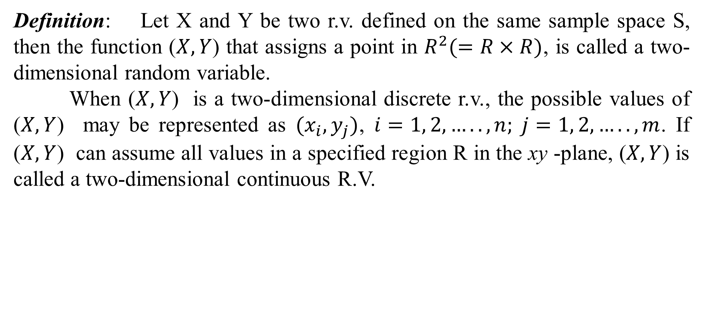
Two-dimensional Random Variables
Definition: Let X and Y be two r.v. defined on the same sample space S, then the function ($X, Y$) that assigns a point in $R^{2}(=R×R)$, is called a two-dimensional random variable.
When ($X, Y$) is a two-dimensional discrete r.v., the possible values of ($X, Y$) may be represented as $(x_{i},y_{j})$, $i=1, 2, …..,n; j=1, 2,…..,m$. If ($X, Y$) can assume all values in a specified region R in the xy -plane, ($X, Y$) is called a two-dimensional continuous R.V.

Slide 26
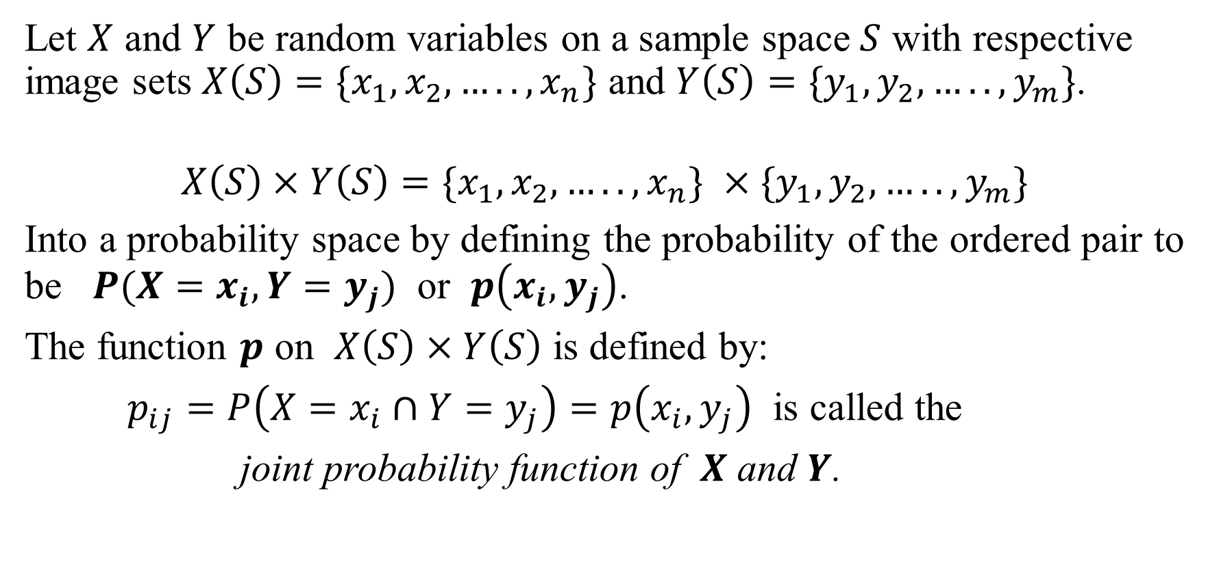
Joint Probability Function
Let $X$ and $Y$ be random variables on a sample space $S$ with respective image sets $X\left(S\right)=\{x_{1},x_{2},…..,x_{n}\}$ and $Y\left(S\right)=\{y_{1},y_{2},…..,y_{m}\}$.
$$X\left(S\right)×Y\left(S\right)=\{x_{1},x_{2},…..,x_{n}\} ×\{y_{1},y_{2},…..,y_{m}\}$$
Into a probability space by defining the probability of the ordered pair to be $P(X=x_{i},Y=y_{j})$ or $p\left(x_{i},y_{j}\right)$.
The function $p$ on $X\left(S\right)×Y\left(S\right)$ is defined by:
$p_{ij}=P\left(X=x_{i}∩Y=y_{j}\right)=p\left(x_{i},y_{j}\right)$ is called the
joint probability function of $X$ and $Y$.

Slide 27
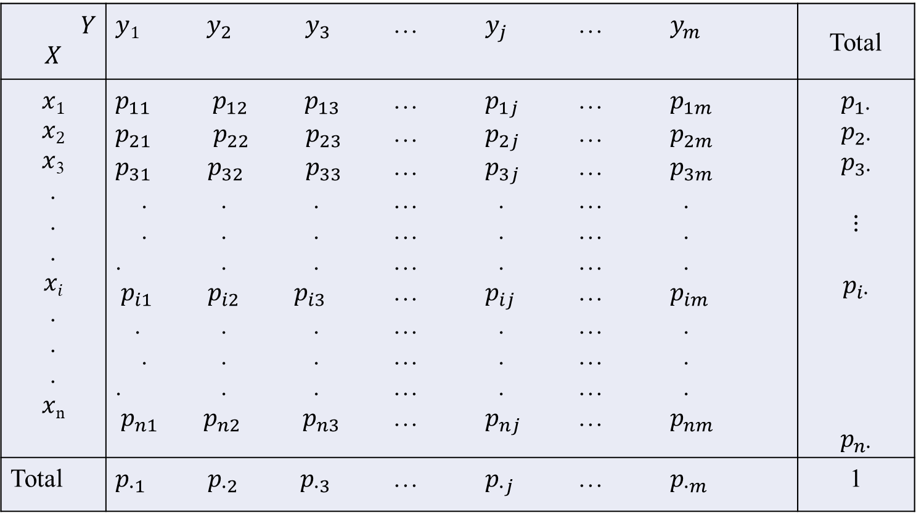
$$Y$$ $$X$$ | $y1{ y}_{2}{ y}_{3}$ … $y_{j}$ … $y_{m}$ | Total
$$x1$$ $$x2$$ $x$₃ . . . $$xi$$ . . . $x$_{n} | $p_{11}{ p}_{12}{ p}_{13}$ … $p_{1j}$ … $p_{1m}$ $p_{21}{ p}_{22}{ p}_{23}$ … $p_{2j}$ … $p_{2m}$ $p_{31}{ p}_{32}{ p}_{33}$ … $p_{3j}$ … $p_{3m}$ . . . … . … . . . . … . … . . . . … . … . ${ p}_{i1 }p_{i2 }p_{i3}$ … $p_{ij}$ … $p_{im}$ . . . … . … . . . . … . … . . . . … . … . ${ p}_{n1}{ p}_{n2}{ p}_{n3}$ … $p_{nj}$ … $p_{nm}$ | $$p_{1∙}$$ $$p_{2∙}$$ $$p_{3∙}$$ $$⋮$$ $$p_{i∙}$$ $$p_{n∙}$$
Total | $p_{∙1}{ p}_{∙2}{ p}_{∙3}$ … $p_{∙j}$ … $p_{∙m}$ | 1

Slide 28
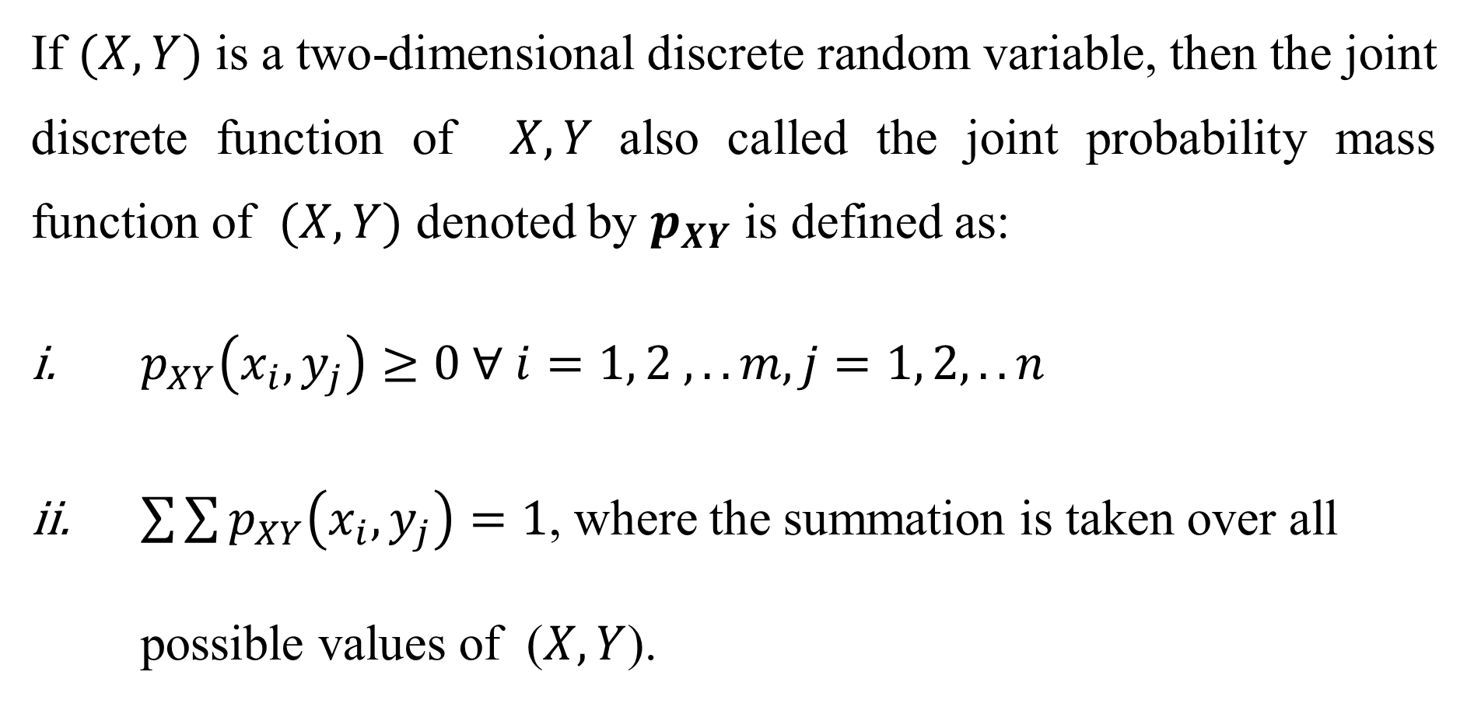
Joint probability mass function:
If $(X, Y)$ is a two-dimensional discrete random variable, then the joint discrete function of $X, Y$also called the joint probability mass function of $(X, Y)$ denoted by $p_{XY}$ is defined as:
$p_{XY}\left(x_{i}, y_{j}\right)≥0 ∀ i=1, 2 ,..m, j=1, 2, ..n$
$\sum{\sum{p_{XY}\left(x_{i}, y_{j}\right)}}=1$, where the summation is taken over all possible values of ($X, Y$).

Slide 29
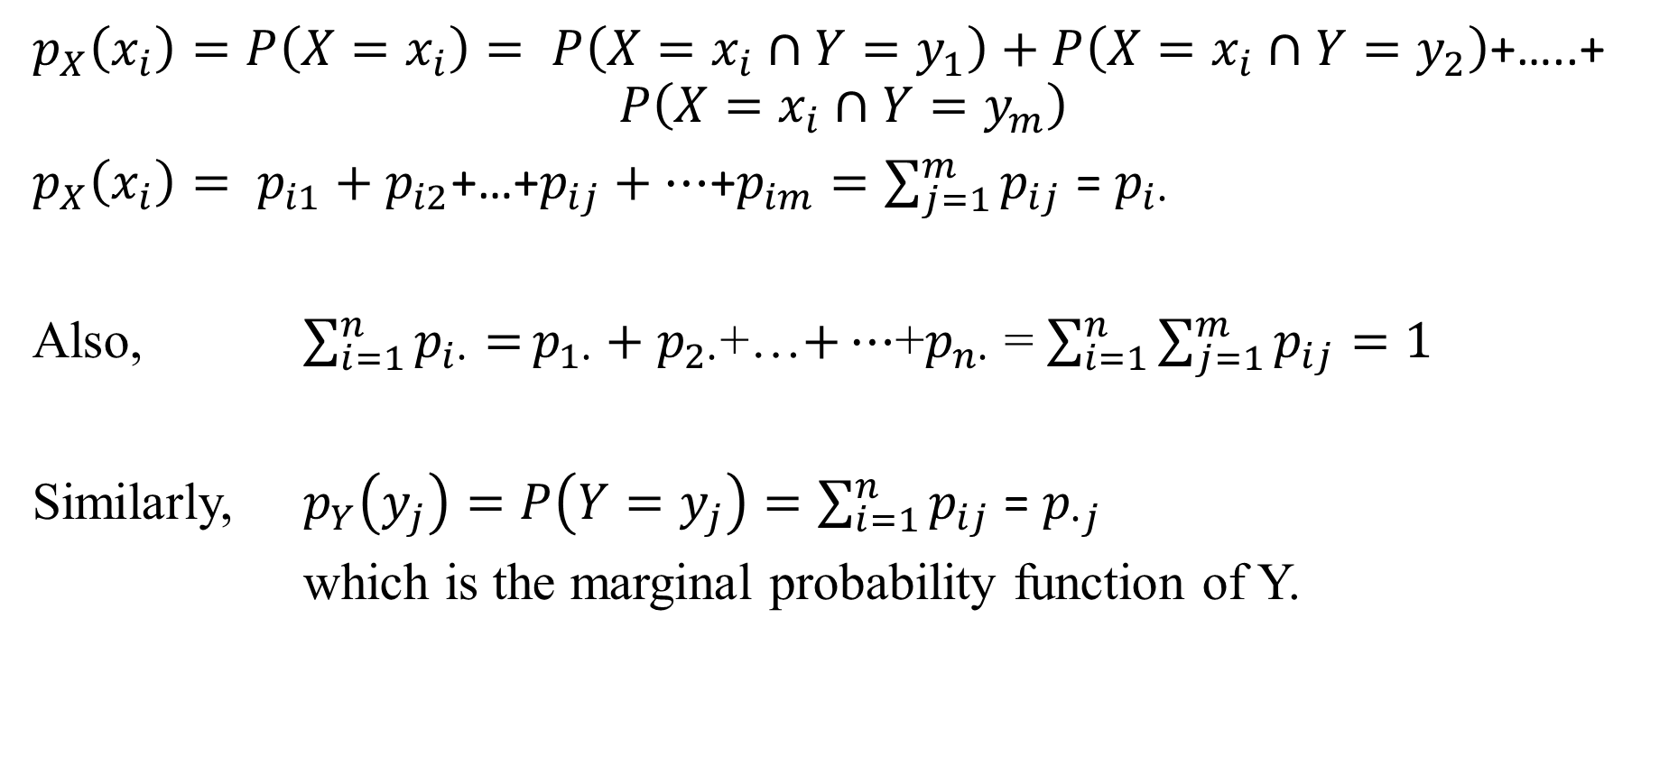
Marginal Probability Function:
$p_{X}\left(x_{i}\right)=P\left(X=x_{i}\right)= P\left(X=x_{i}∩Y=y_{1}\right)+P\left(X=x_{i}∩Y=y_{2}\right)$+…..+
$$P\left(X=x_{i}∩Y=y_{m}\right)$$
$p_{X}\left(x_{i}\right)= p_{i1}+p_{i2}$+…+$p_{ij}+…$+$p_{im}=\sum_{j=1}^{m}{p_{ij}}$ = $p_{i∙}$
Also, $\sum_{i=1}^{n}{p_{i∙}=}p_{1∙}+p_{2∙}$+…$+…$+$p_{n∙}$ = $\sum_{i=1}^{n}{\sum_{j=1}^{m}{p_{ij}=1}}$
Similarly, $p_{Y}\left(y_{j}\right)=P\left(Y=y_{j}\right)=\sum_{i=1}^{n}{p_{ij}}$ = $p_{∙j}$
which is the marginal probability function of Y.

Slide 30
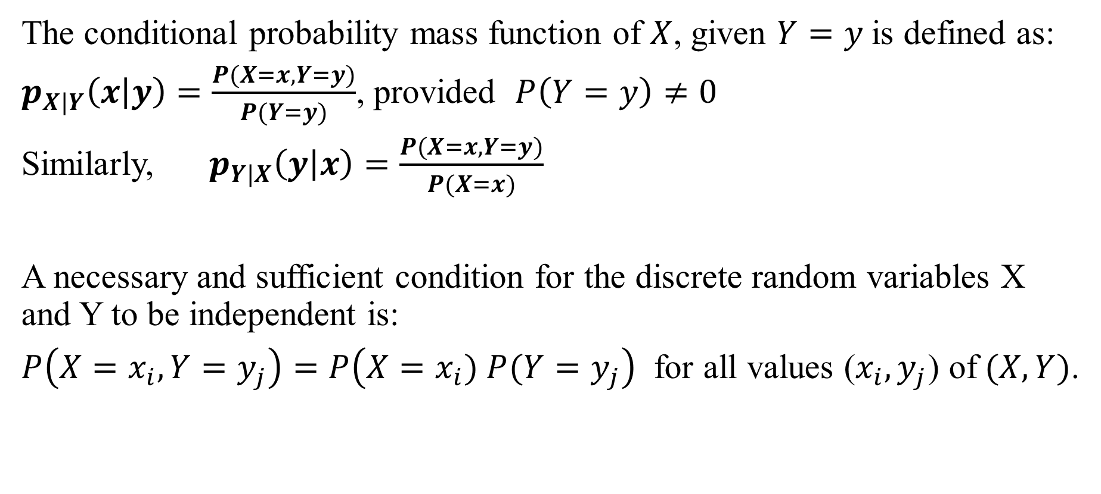
Conditional Probability Function:
The conditional probability mass function of $X$, given $Y=y$is defined as:
$p_{X|Y}\left(x | y\right)=\frac{P(X=x, Y=y)}{P(Y=y)}$, provided $P\left(Y=y\right)≠0$
Similarly, $p_{Y|X}\left(y | x\right)=\frac{P(X=x, Y=y)}{P(X=x)}$
A necessary and sufficient condition for the discrete random variables X and Y to be independent is:
$P\left(X=x_{i},Y=y_{j}\right)=P\left(X=x_{i}) P(Y=y_{j}\right)$ for all values ($x_{i},y_{j}$) of$(X,Y)$.

Slide 31
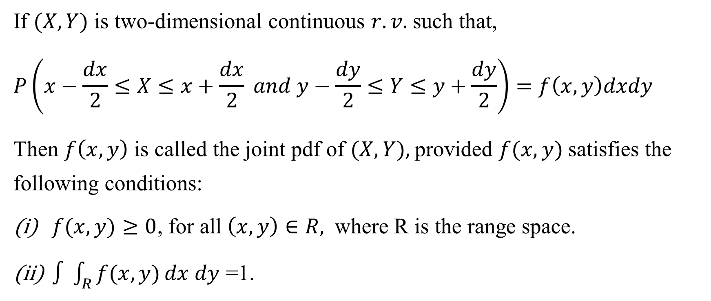
Joint Probability Density Function
If $(X, Y)$ is two-dimensional continuous $r.v.$ such that,
$$P\left(x−\frac{dx}{2}≤X≤x+\frac{dx}{2} and y−\frac{dy}{2}≤Y≤y+\frac{dy}{2}\right)=f\left(x, y\right)dxdy$$
Then $f\left(x,y\right)$ is called the joint pdf of $(X, Y),$provided $f(x, y)$satisfies the following conditions:
$f(x,y)≥0$, for all $\left(x,y\right)∈R,$ where R is the range space.
$∫\int_{R}{f(x, y)}dx dy$ =1.

Slide 32
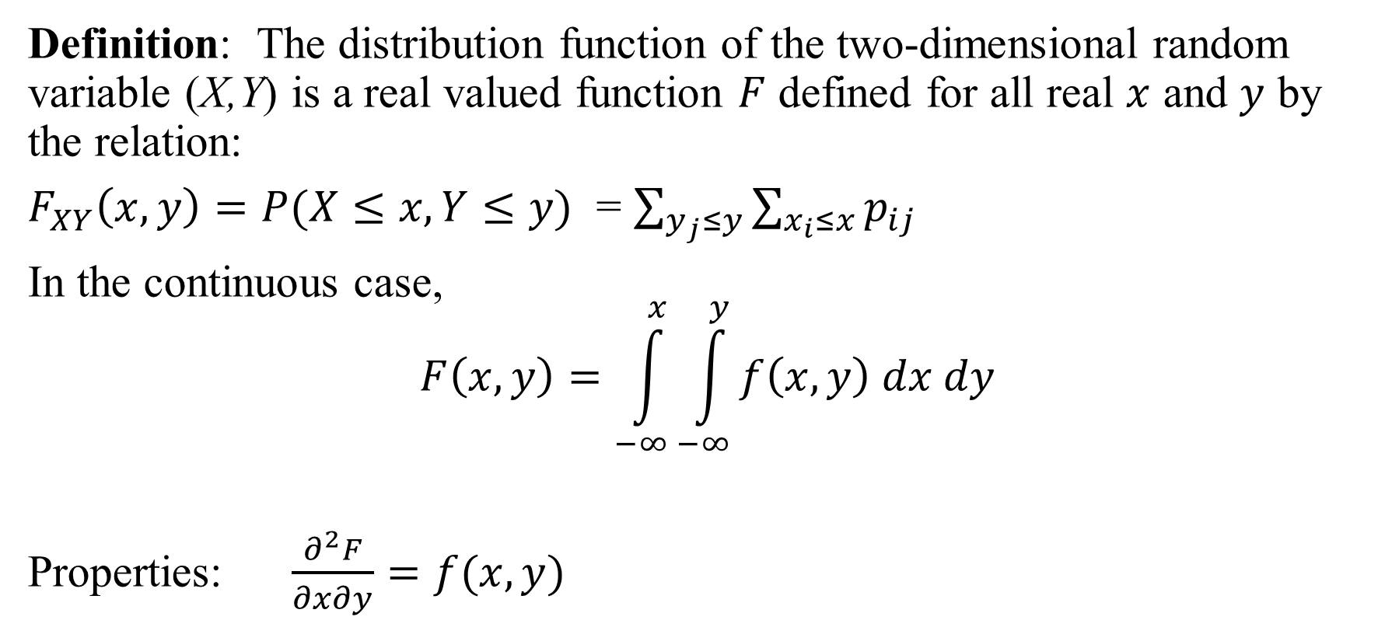
Two-dimensional distribution function
Definition: The distribution function of the two-dimensional random variable (X,Y) is a real valued function $F$ defined for all real $x$ and $y$ by the relation:
$F_{XY}\left(x,y\right)=P(X≤x,Y≤y)$ = $\sum_{y_{j}≤y}{\sum_{x_{i}≤x}{p_{ij}}}$
In the continuous case,
$$F\left(x,y\right)=\int_{−∞}^{x}{\int_{−∞}^{y}{f\left(x,y\right) dx dy}}$$
Properties: $\frac{∂^{2}F}{∂x∂y}=f(x,y)$

Slide 33
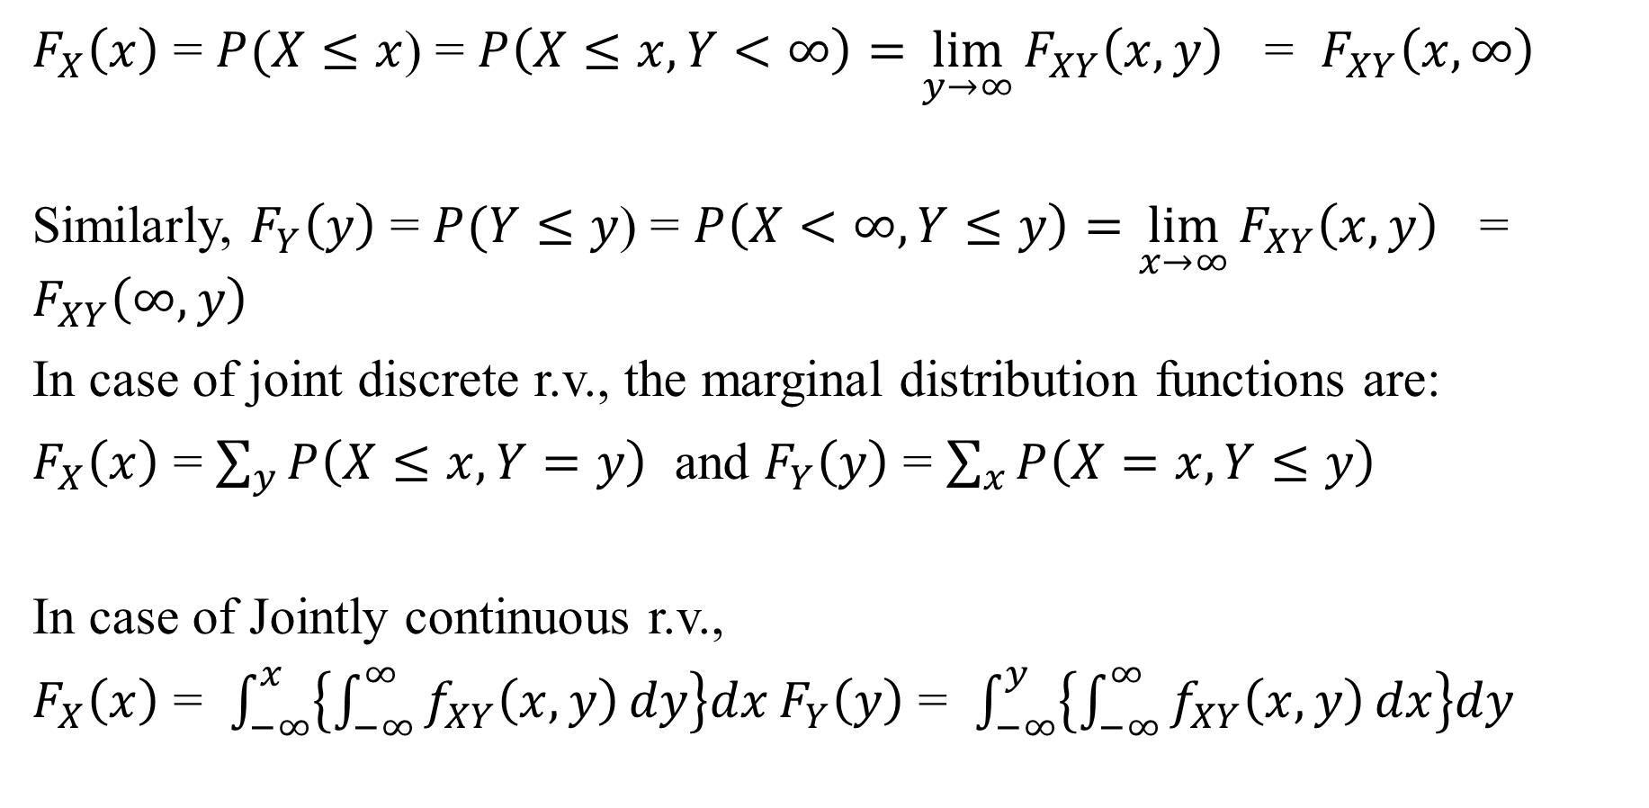
Marginal Distribution Functions:
$F_{X}\left(x\right)$ = $P(X≤x$) = $P\left(X≤x,Y<∞\right)=\lim_{y→∞}{F_{XY}\left(x,y\right)}$ = $F_{XY}\left(x,∞\right)$
Similarly, $F_{Y}\left(y\right)$ = $P(Y≤y$) = $P\left(X<∞,Y≤y\right)=\lim_{x→∞}{F_{XY}\left(x,y\right)}$ = $F_{XY}\left(∞,y\right)$
In case of joint discrete r.v., the marginal distribution functions are:
$F_{X}\left(x\right)$ = $\sum_{y}{P\left(X≤x,Y=y\right)}$ and $F_{Y}\left(y\right)$ = $\sum_{x}{P\left(X=x,Y≤y\right)}$
In case of Jointly continuous r.v.,
$F_{X}\left(x\right)$ = $\int_{−∞}^{x}{\left\{\int_{−∞}^{∞}{f_{XY}\left(x,y\right)}dy\right\}dx}F_{Y}\left(y\right)$ = $\int_{−∞}^{y}{\left\{\int_{−∞}^{∞}{f_{XY}\left(x,y\right)}dx\right\}dy}$

Slide 34
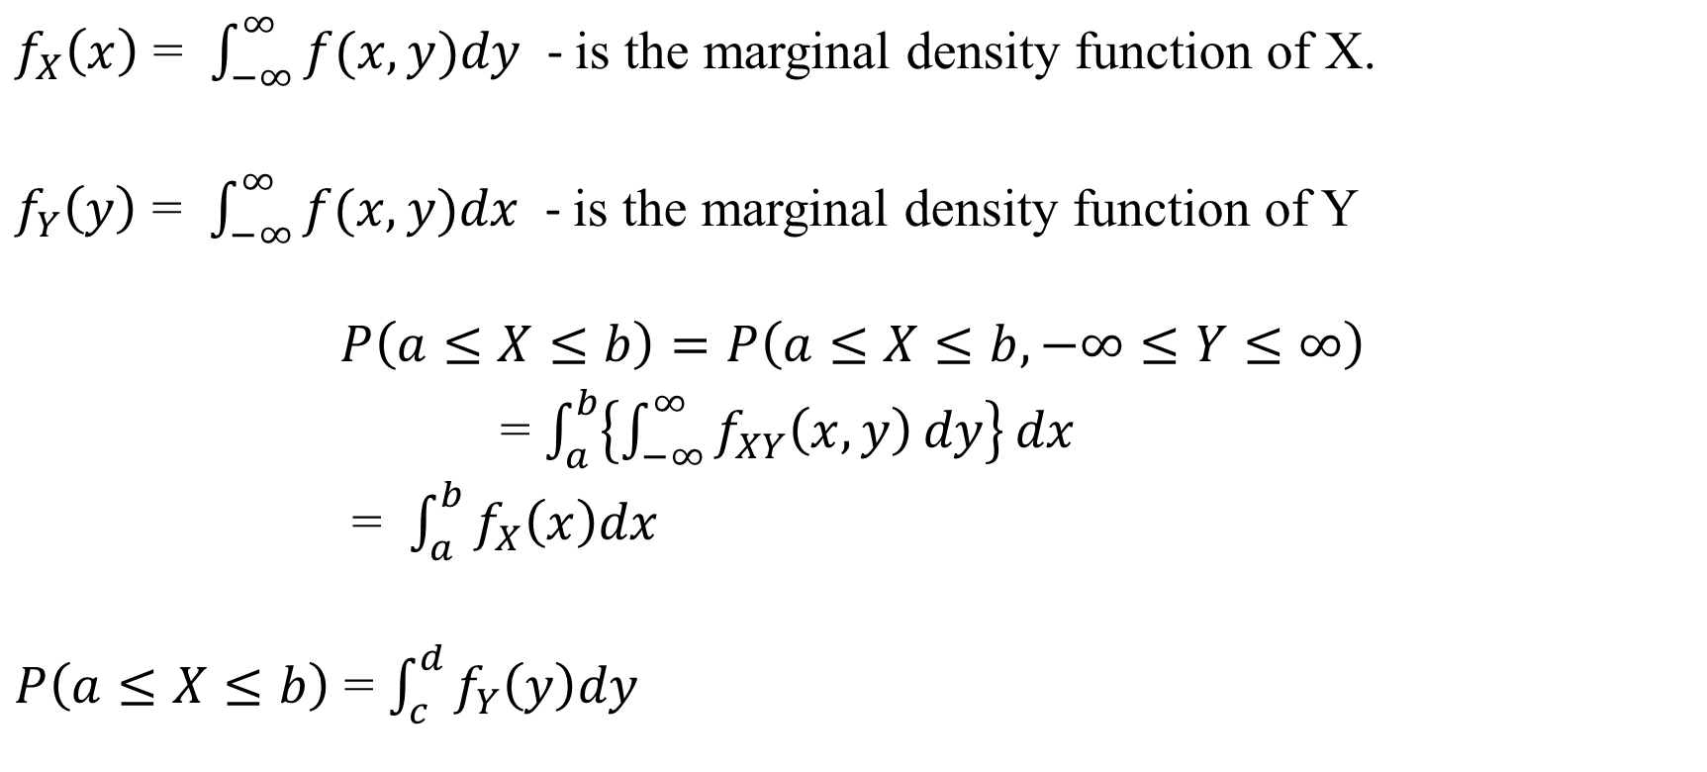
Marginal Density function:
$f_{X}\left(x\right)$ = $\int_{−∞}^{∞}{f(x,y)dy}$ - is the marginal density function of X.
$f_{Y}\left(y\right)$ = $\int_{−∞}^{∞}{f(x,y)dx}$ - is the marginal density function of Y
$$P\left(a≤X≤b\right)=P\left(a≤X≤b, −∞≤Y≤∞\right)$$
= $\int_{a}^{b}{\left\{\int_{−∞}^{∞}{f_{XY}\left(x,y\right)}dy\right\}}dx$
= $\int_{a}^{b}{f_{X}\left(x\right)dx}$
$P\left(a≤X≤b\right)$ = $\int_{c}^{d}{f_{Y}\left(y\right)dy}$

Slide 35

Independent RVs
If $(X,Y)$ is two-dimensional independent RVs,
$P(X=x, Y=y) = P(X=x) ∙ P(Y=y)$ - Discrete
$f(x,y)$ = $f\left(x\right)∙f\left(y\right)$ - Continuous

Slide 36
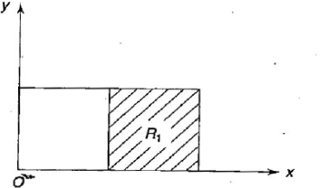
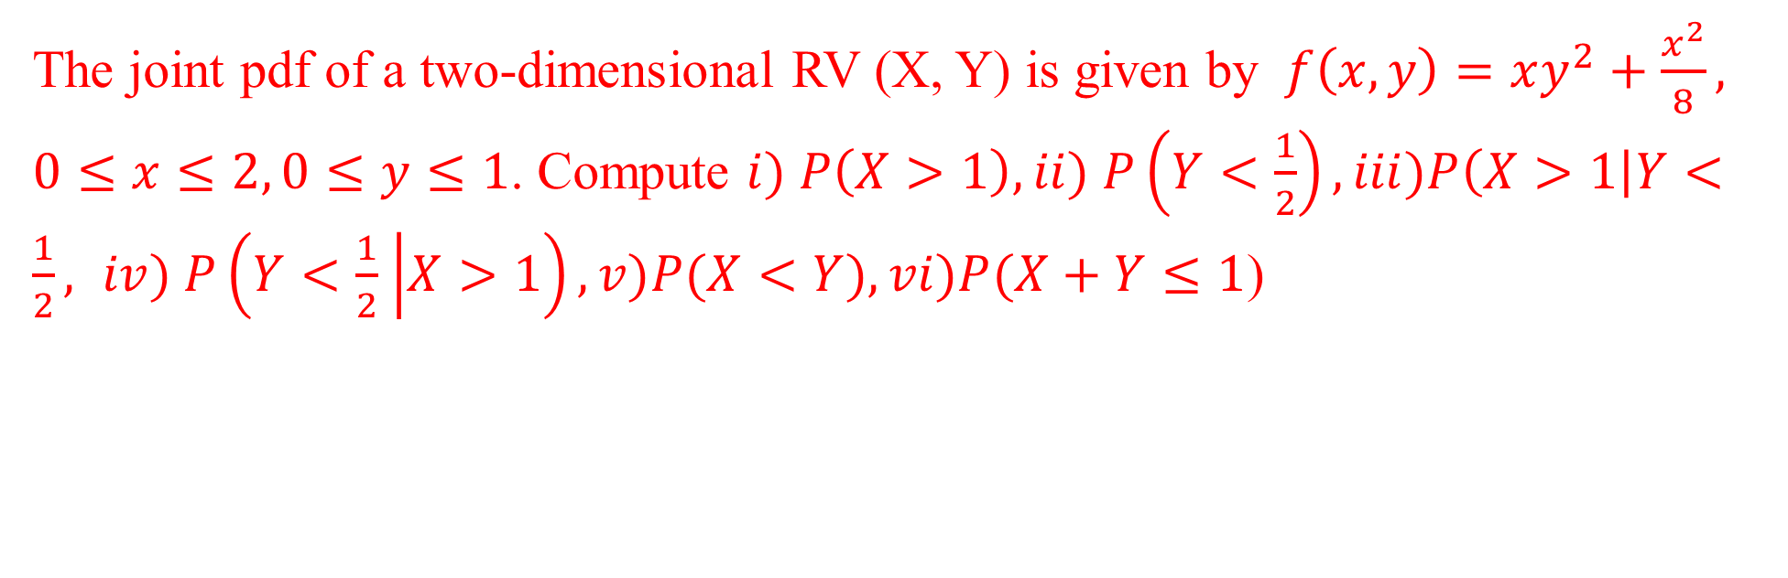
The joint pdf of a two-dimensional RV (X, Y) is given by $f\left(x, y\right)=xy^{2}+\frac{x^{2}}{8}, 0≤x≤2, 0≤y≤1$. Compute $i) P\left(X>1\right), ii) P\left(Y<\frac{1}{2}\right), iii)P\left(X>1\right|Y<\frac{1}{2}, iv) P\left(Y<\frac{1}{2} | X>1\right),v)P(X<Y),vi)P(X+Y≤1$)

Slide 37
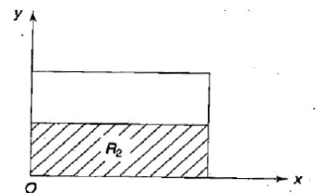

Slide 38
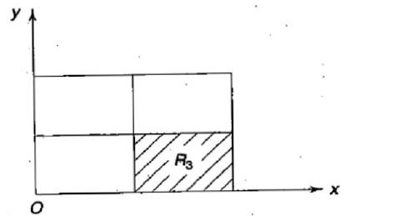

Slide 40
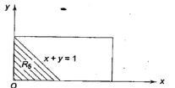

Slide 41

For a bivariate probability distribution of $(X,Y)$given below,
Find $P\left(X≤1\right), P\left(Y≤3\right),P\left(X≤1,Y≤3\right), P\left(X≤1 | Y≤3\right), P(Y≤3|X≤1)$, $P(X+Y≤4)$
X Y | 1 | 2 | 3 | 4 | 5 | 6
0 | 0 | 0 | 1/32 | 2/32 | 2/32 | 3/32
1 | 1/16 | 1/16 | 1/8 | 1/8 | 1/8 | 1/8
2 | 1/32 | 1/32 | 1/64 | 1/64 | 0 | 2/64

Slide 42
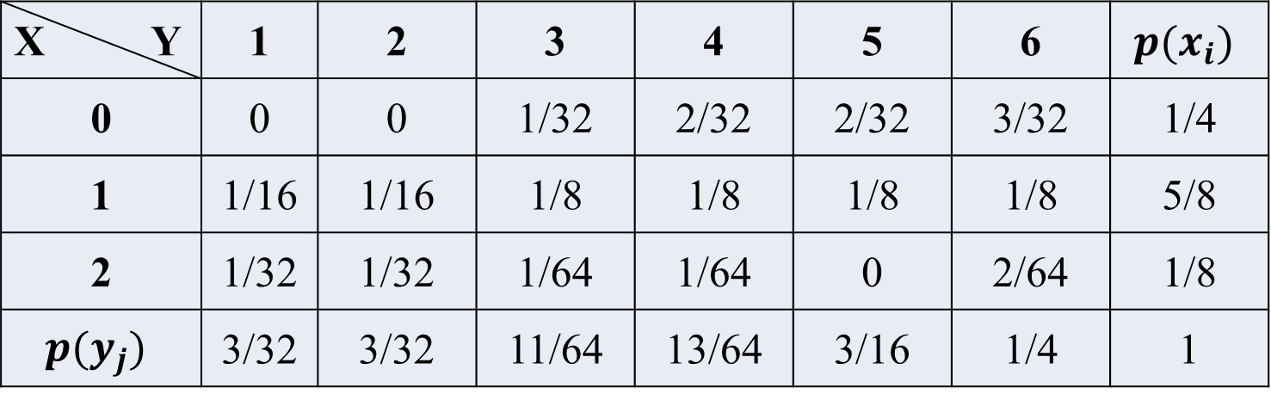

$P\left(X≤1\right)$ = $P\left(X=0\right)+P\left(X=1\right)$
= $\sum_{j=1}^{6}{P(X=0,Y=j) }$+ $\sum_{j=1}^{6}{P(X=1,Y=j) }$ = $\frac{1}{4}+\frac{5}{8}=\frac{7}{8}$
X Y | 1 | 2 | 3 | 4 | 5 | 6 | $$p(x_{i})$$
0 | 0 | 0 | 1/32 | 2/32 | 2/32 | 3/32 | 1/4
1 | 1/16 | 1/16 | 1/8 | 1/8 | 1/8 | 1/8 | 5/8
2 | 1/32 | 1/32 | 1/64 | 1/64 | 0 | 2/64 | 1/8
$$p(y_{j})$$ | 3/32 | 3/32 | 11/64 | 13/64 | 3/16 | 1/4 | 1

Slide 43
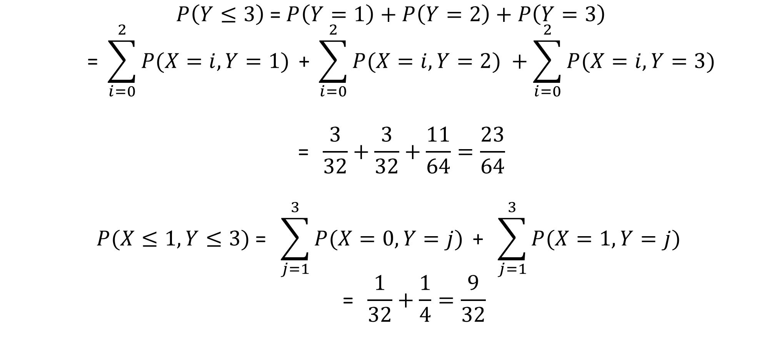
$$P\left(Y≤3\right)\text{ = }P\left(Y=1\right)+P\left(Y=2\right)+P\left(Y=3\right)$$
$$\text{ = }\sum_{i=0}^{2}{P(X=i,Y=1) }\text{+ }\sum_{i=0}^{2}{P(X=i,Y=2) }+\sum_{i=0}^{2}{P(X=i,Y=3) }$$
$$\text{ = }\frac{3}{32}+\frac{3}{32}+\frac{11}{64}=\frac{23}{64}$$
$$P(X≤1,Y≤3)\text{ = }\sum_{j=1}^{3}{P(X=0,Y=j) }\text{+ }\sum_{j=1}^{3}{P(X=1,Y=j) }$$
$$\text{ = }\frac{1}{32}+\frac{1}{4}=\frac{9}{32}$$

Slide 44
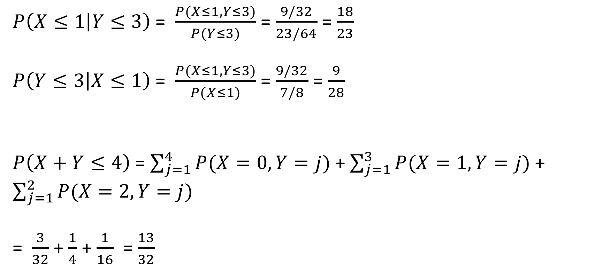
$P\left(X≤1 | Y≤3\right)$ = $\frac{P(X≤1,Y≤3)}{P(Y≤3)}$ = $\frac{9/32}{23/64}$ = $\frac{18}{23}$
$P\left(Y≤3 | X≤1\right)$ = $\frac{P(X≤1,Y≤3)}{P(X≤1)}$ = $\frac{9/32}{7/8}$ = $\frac{9}{28}$
$P\left(X+Y≤4\right)$ = $\sum_{j=1}^{4}{P(X=0,Y=j) }$+ $\sum_{j=1}^{3}{P(X=1,Y=j) }$+ $\sum_{j=1}^{2}{P(X=2,Y=j) }$
= $\frac{3}{32}$ + $\frac{1}{4}$ + $\frac{1}{16}$ = $\frac{13}{32}$

Slide 45
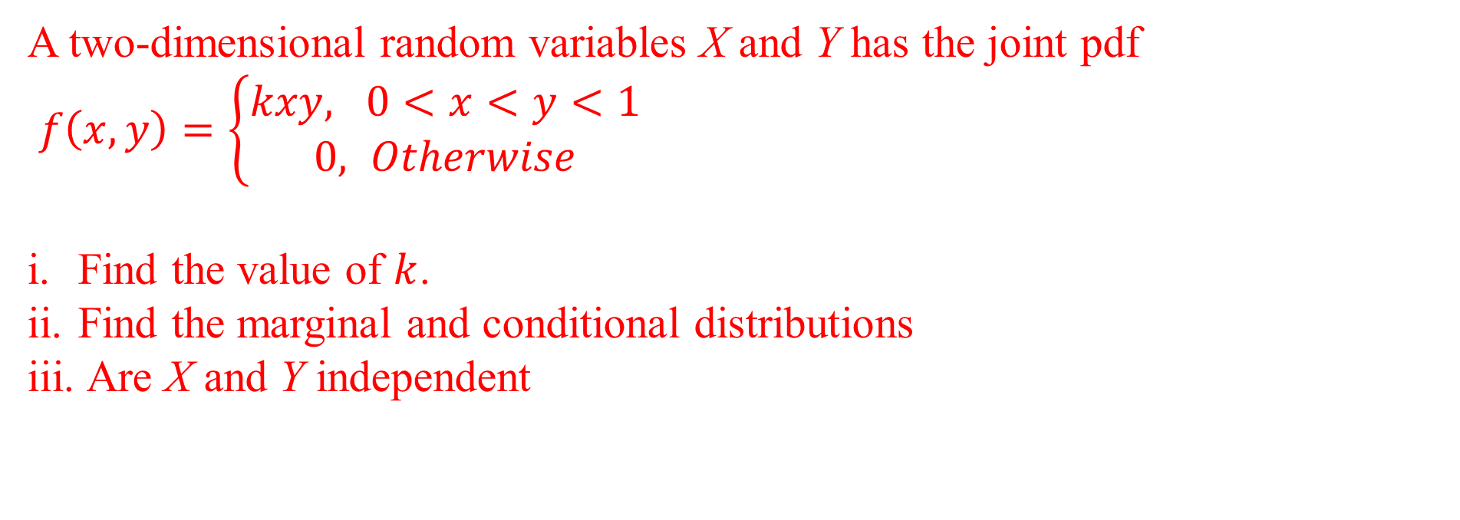
A two-dimensional random variables X and Y has the joint pdf
$f\left(x, y\right)=\left\{\begin{aligned}kxy, 0<x<y<1 \\ 0, Otherwise\end{aligned}\right.$
Find the value of $k$.
Find the marginal and conditional distributions
Are X and Y independent

Slide 50
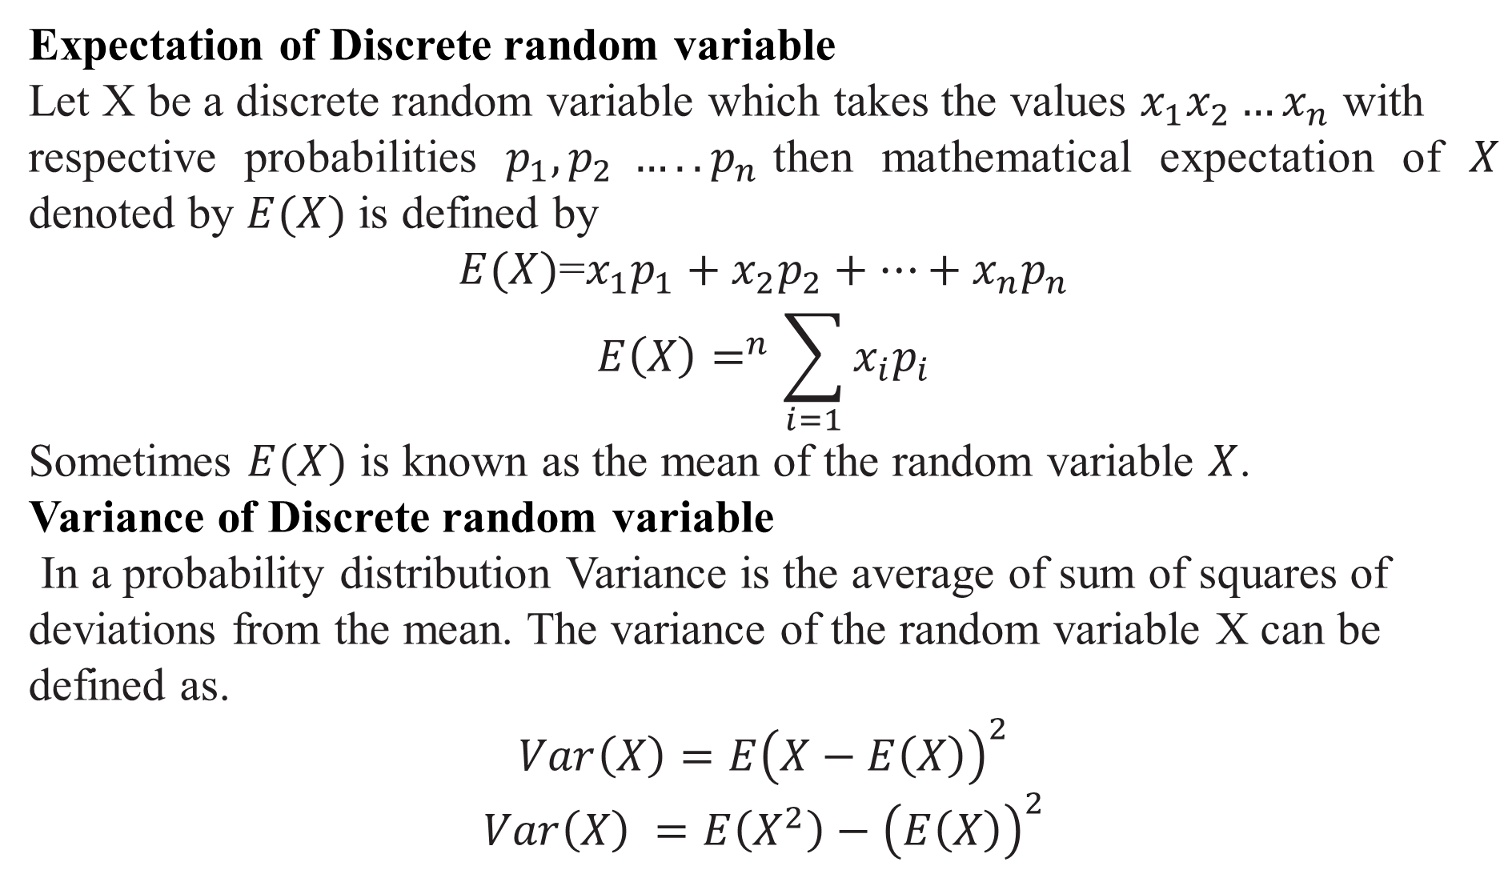
Expectation of Discrete random variable
Let X be a discrete random variable which takes the values $x_{1}x_{2}…x_{n}$ with
respective probabilities $p_{1}, p_{2} ….. p_{n}$then mathematical expectation of $X$ denoted by $E(X)$ is defined by
$E(X)$=$x_{1}p_{1}+x_{2}p_{2}+…+x_{n}p_{n}$
$$E\left(X\right)=^{n}\sum_{i=1}{x_{i}p_{i}}$$
Sometimes $E(X)$ is known as the mean of the random variable $X$.
Variance of Discrete random variable
In a probability distribution Variance is the average of sum of squares of
deviations from the mean. The variance of the random variable X can be defined as.
$$Var\left(X\right)=E{\left(X−E\left(X\right)\right)}^{2}$$
$$Var\left(X\right) =E\left(X^{2}\right)−{\left(E\left(X\right)\right)}^{2}$$

Slide 51
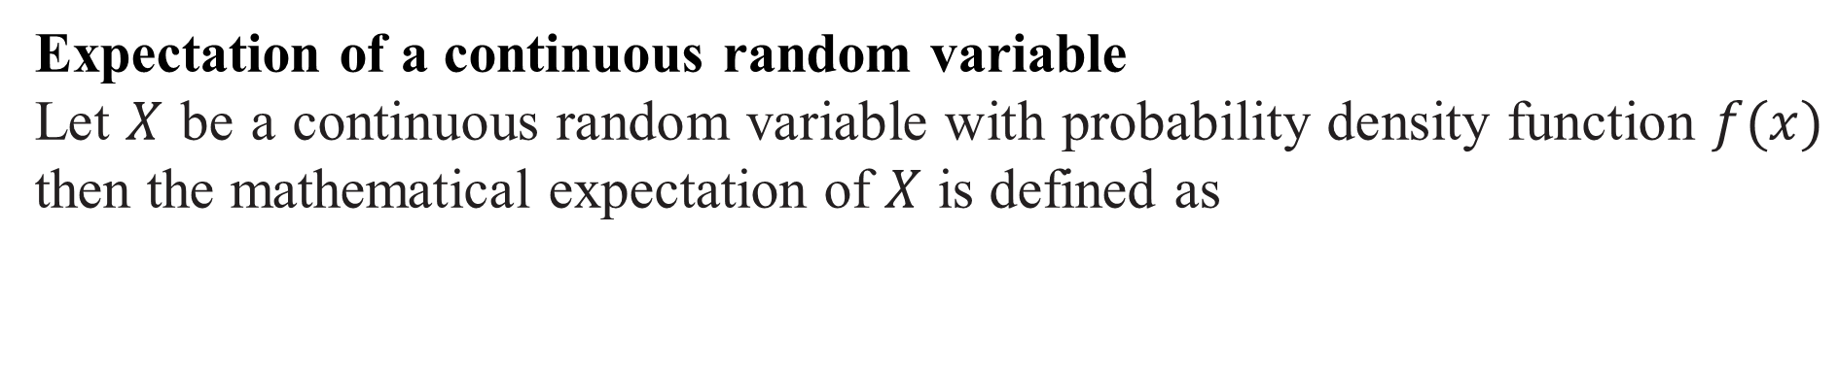
Expectation of a continuous random variable
Let $X$ be a continuous random variable with probability density function $f(x)$ then the mathematical expectation of $X$ is defined as

Slide 52
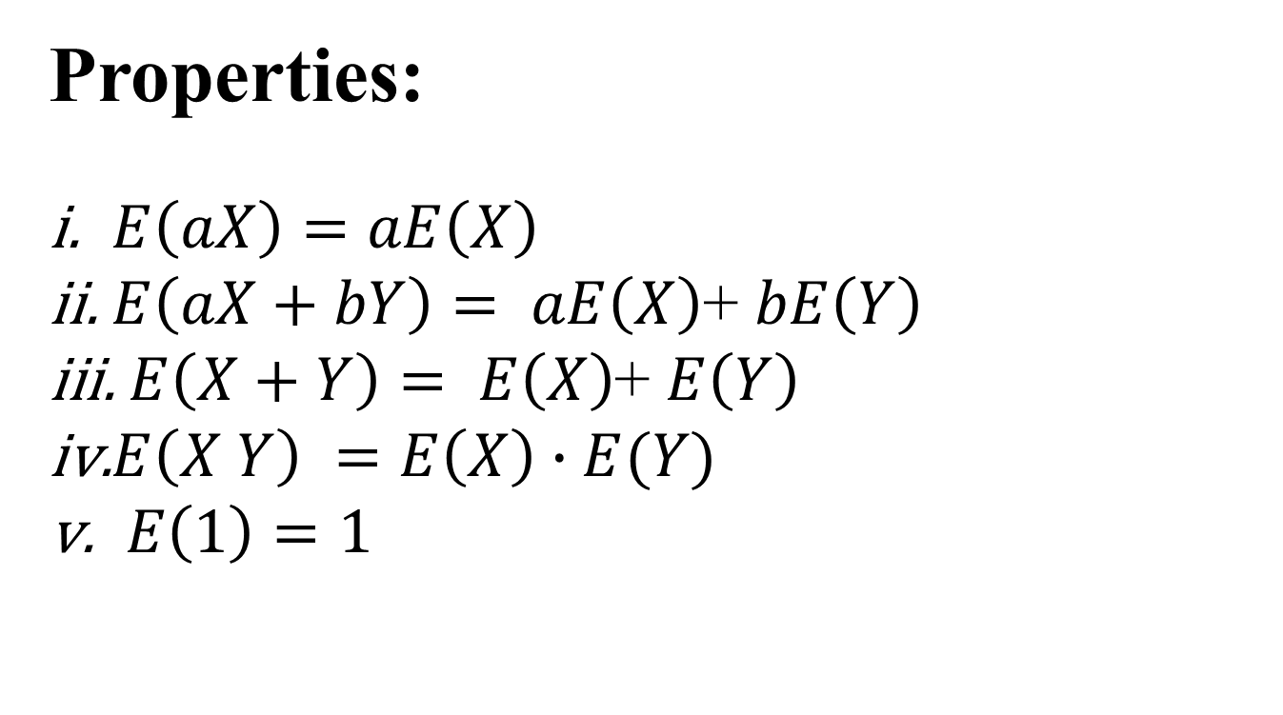
Properties:
$E\left(aX\right)=aE\left(X\right)$
$E\left(aX+bY\right)= aE\left(X\right)$+ $bE\left(Y\right)$
$E\left(X+Y\right)= E\left(X\right)$+ $E\left(Y\right)$
$E\left(X Y\right) =E\left(X\right)∙E(Y)$
$E\left(1\right)=1$

Slide 53
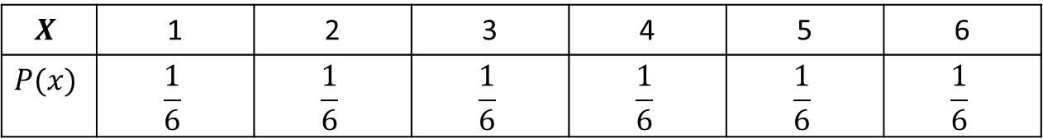
When a die is thrown $X$denotes the number turns up. Find $E\left(X\right), E\left(X^{2}\right), Var\left(X\right).$
Solution:
$$X$$ | 1 | 2 | 3 | 4 | 5 | 6
$$P(x)$$ | $$\frac{1}{6}$$ | $$\frac{1}{6}$$ | $$\frac{1}{6}$$ | $$\frac{1}{6}$$ | $$\frac{1}{6}$$ | $$\frac{1}{6}$$

Slide 54
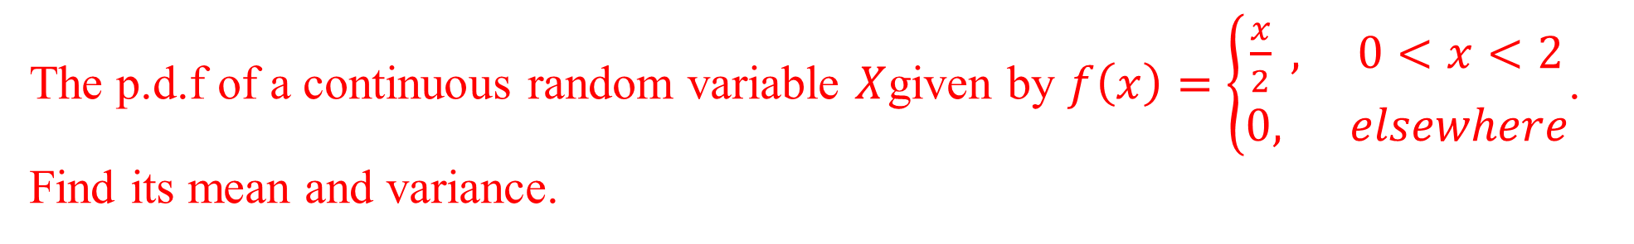
The p.d.f of a continuous random variable $X$given by $f\left(x\right)=\left\{\begin{aligned}\frac{x}{2} , 0<x<2 \\ 0, elsewhere\end{aligned}\right.$. Find its mean and variance.

Slide 55
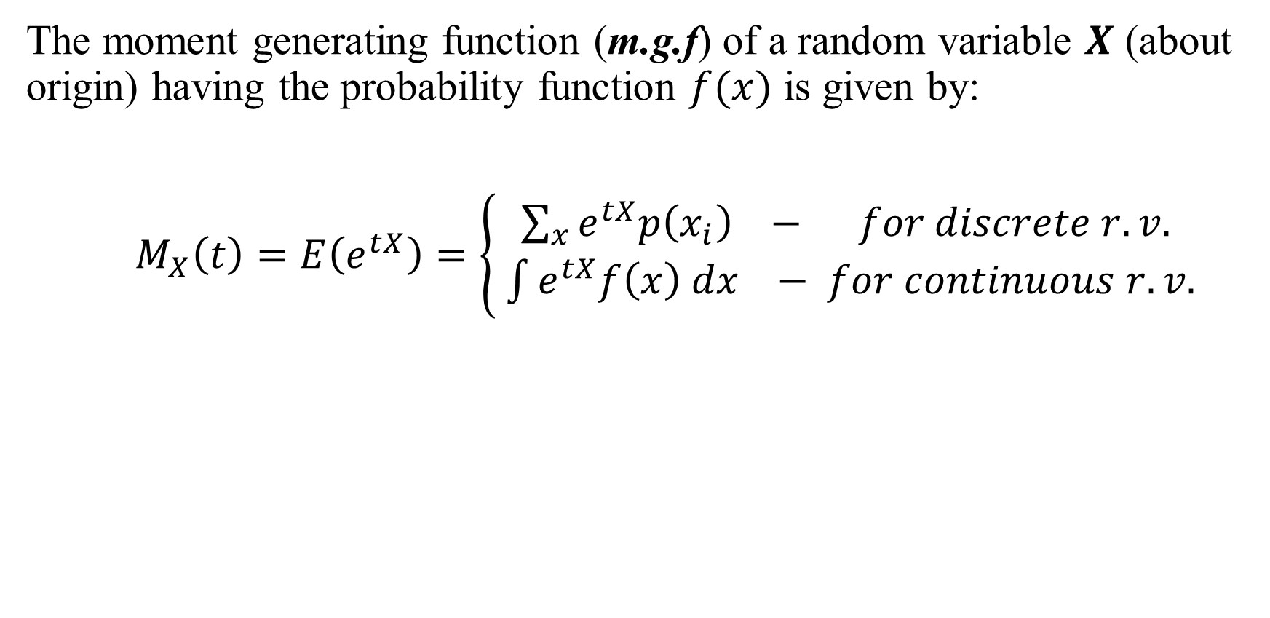
Moment Generating Function
The moment generating function (m.g.f) of a random variable $X$ (about origin) having the probability function $f(x)$ is given by:
$M_{X}\left(t\right)=E\left(e^{tX}\right)=\left\{\begin{aligned}\sum_{x}{e^{tX}p\left(x_{i}\right) − for discrete r.v.} \\ \int{e^{tX}f\left(x\right) dx} − for continuous r.v.\end{aligned}\right.$

Slide 56
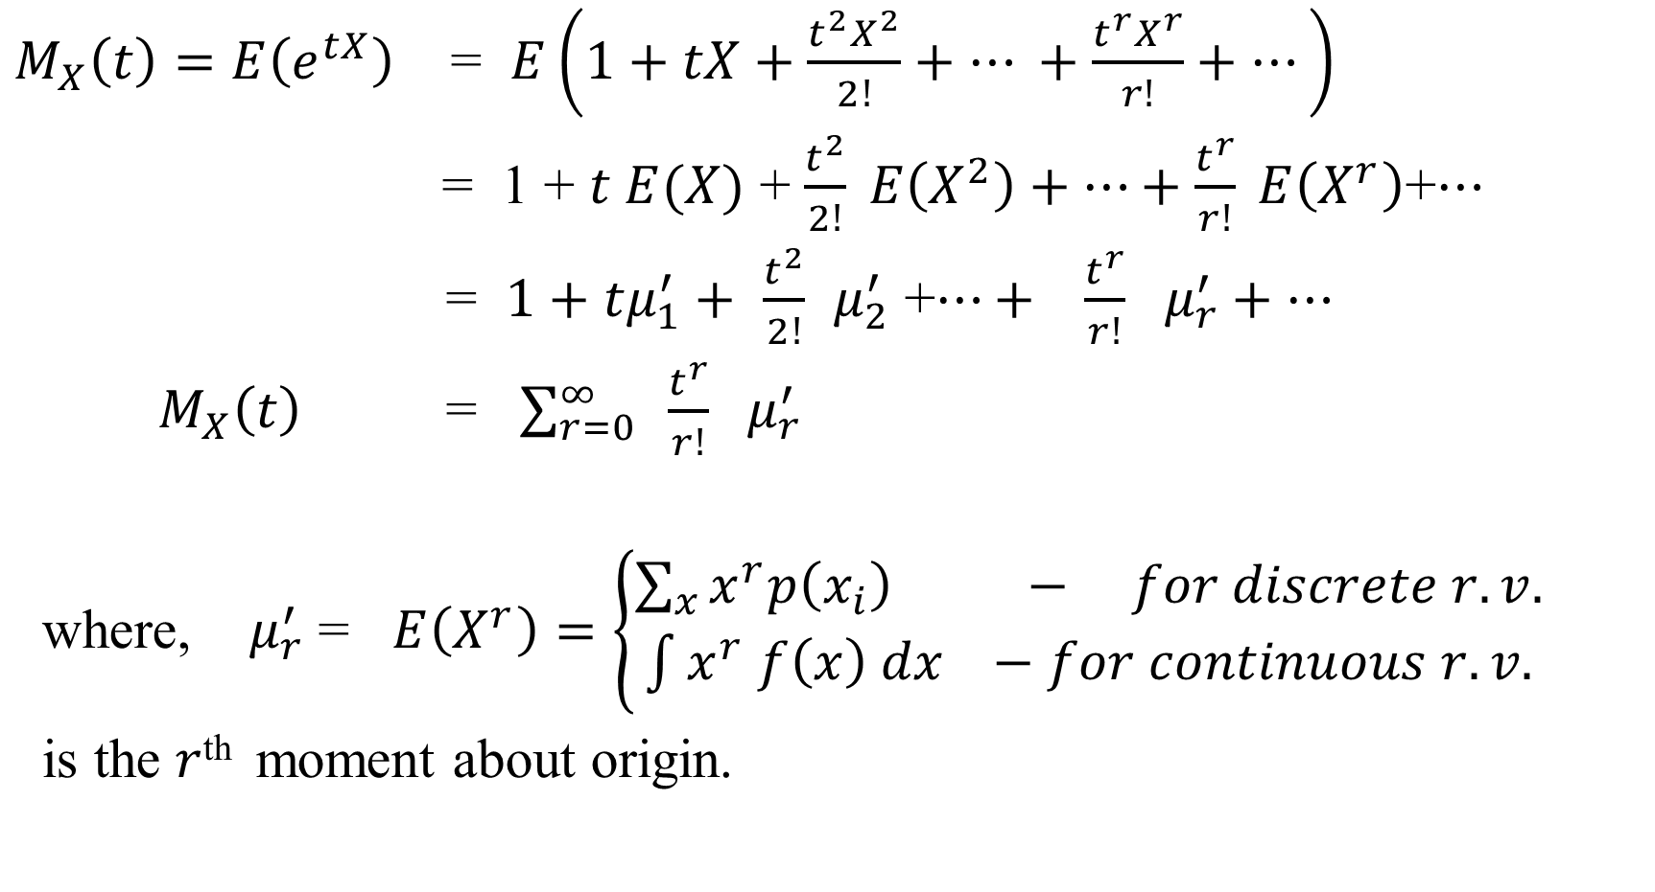
$M_{X}\left(t\right)=E\left(e^{tX}\right)$ = $E\left(1+tX+\frac{t^{2}X^{2}}{2!}+… +\frac{t^{r}X^{r}}{r!}+…\right)$
= 1 + $t E(X)$ + $\frac{t^{2}}{2!} E\left(X^{2}\right)+…+\frac{t^{r}}{r!} E\left(X^{r}\right)$+$…$
= $1+tμ_{1}^{′}+$ $\frac{t^{2}}{2!}$ $μ_{2}^{′}$ +$…+ \frac{t^{r}}{r!} μ_{r}^{′}+…$
$M_{X}\left(t\right)$ = $\sum_{r=0}^{∞}{ \frac{t^{r}}{r!} μ_{r}^{′}}$
where, $μ_{r}^{′}$ = $E\left(X^{r}\right)=\left\{\begin{aligned}\sum_{x}{x^{r}p\left(x_{i}\right) − for discrete r.v.} \\ \int{x^{r} f\left(x\right) dx} −for continuous r.v.\end{aligned}\right.$
is the $r$^{th} moment about origin.

Slide 57

Properties:
$M_{cX}\left(t\right)=M_{X}(ct)$ , c - being a constant.
$M_{X_{1}+X_{2}+…+X_{n}}\left(t\right)=M_{X_{1}}\left(t\right)M_{X_{2}}\left(t\right)…M_{X_{n}}\left(t\right)$
$M_{X}\left(t\right)=M_{Y}\left(t\right)⇒X and Y$ are identically distributed.

Slide 58
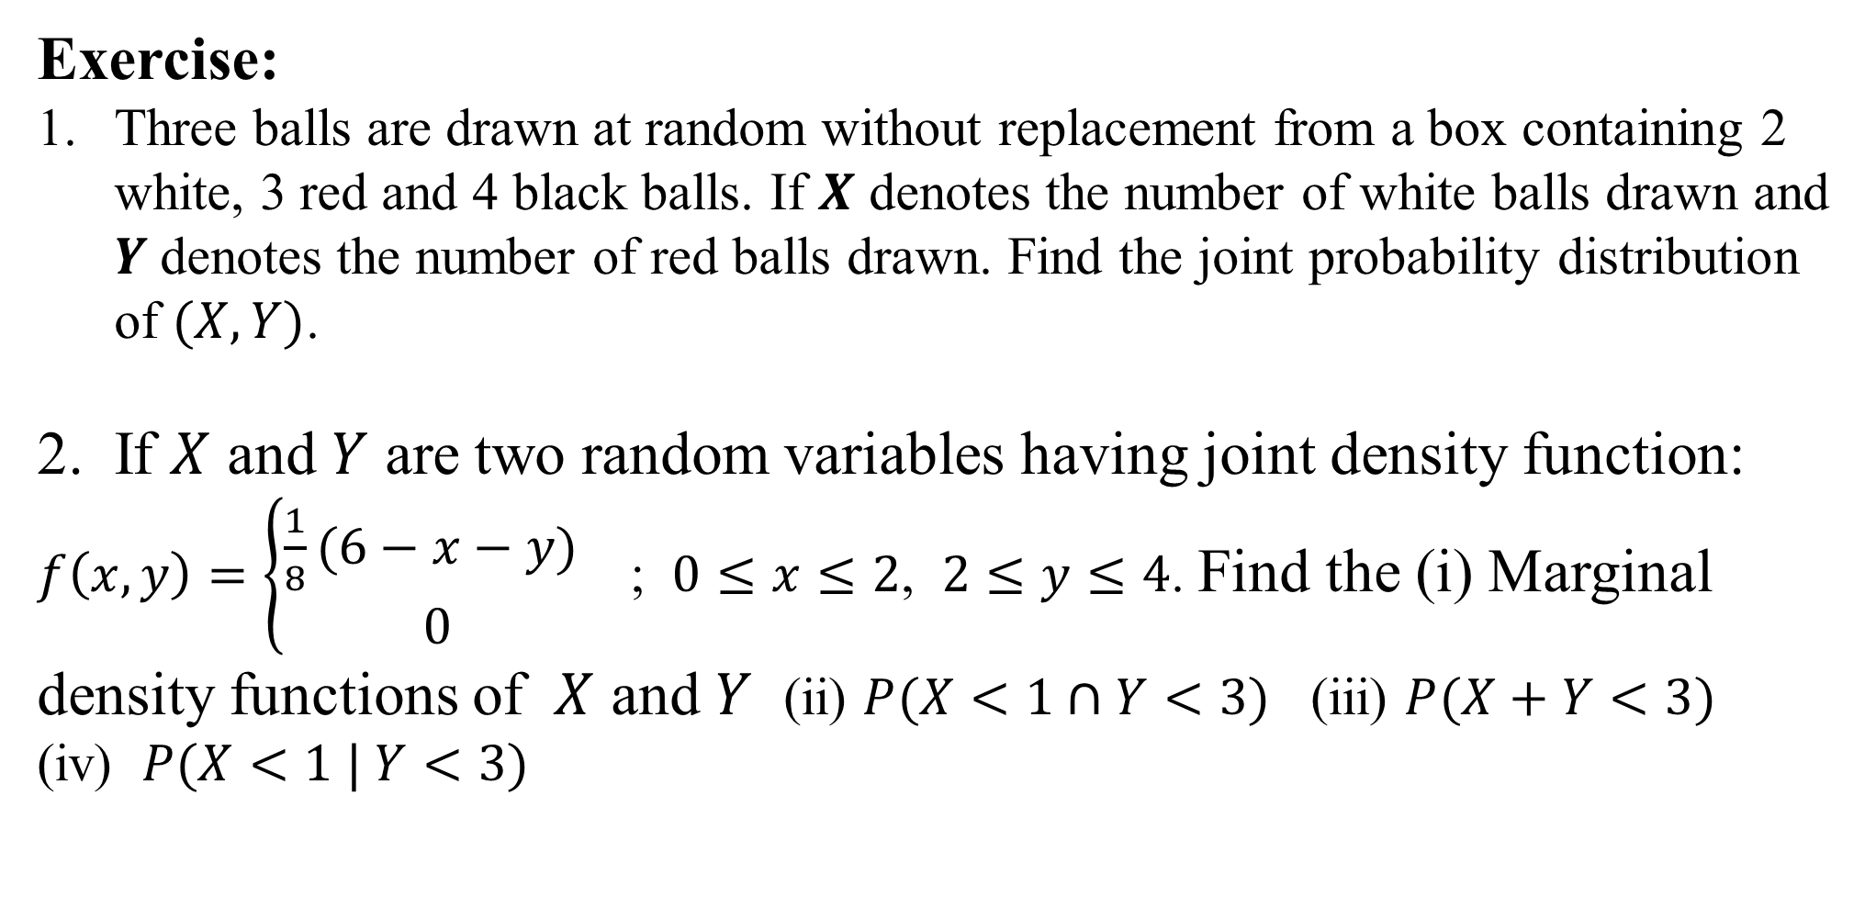
Exercise:
Three balls are drawn at random without replacement from a box containing 2 white, 3 red and 4 black balls. If $X$ denotes the number of white balls drawn and $Y$denotes the number of red balls drawn. Find the joint probability distribution of $(X, Y)$.
If $X$ and $Y$ are two random variables having joint density function:
$f\left(x,y\right)=\left\{\begin{aligned}\frac{1}{8}(6−x−y) \\ 0\end{aligned}\right.$ ; $0≤x≤2$, $2≤y≤4$. Find the (i) Marginal density functions of $X$ and $Y$ (ii) $P(X<1∩Y<3)$ (iii) $P(X+Y<3)$ (iv) $P(X<1 | Y<3)$

Slide 59

Exercise:
3. The joint pdf of a two-dimensional RV (X,Y) is given by
$f\left(x,y\right)=xy^{2}+\frac{x^{2}}{8}$ ; $0≤x≤2$, $0≤y≤1$
Compute $P\left(X>1\right),P(Y<\frac{1}{2})$, $P\left(X>1\right|Y<\frac{1}{2})$, $P(X<Y)$ and
$$P\left(X+Y≤1\right)$$
4. Joint density function of X and Y is given by:$f\left(x,y\right)=4xye^{−\left(x^{2}+y^{2}\right)}$ ; $x≥0, y≥0$
Test whether X and Y are independent.
Find the conditional density function of $X$ given $Y=y.$

Slide 60

Statistical Definition:
If a random experiment or trail results in $‘n’$ exhaustive, mutually exclusive and equally likely outcomes(or cases) , out of which $‘m’$ are favourable to the occurrence of an event $E$, then the probability ‘p’ of occurrence of $E$, denoted by $P(E)$, is given by:
$$p=P\left(E\right)= \frac{Number of favourable cases}{Total number of exhaustive cases} = \frac{m}{n}$$
(i) Since $m≥0, n≥0 and m≤n$
$$P\left(E\right)≥0 and P\left(E\right)≤1 ⟹0≤P\left(E\right) ≤1$$
(ii) $P\left(E\right)+P\left(\overline{E}\right)=1$

Slide 61

Mathematical Expectation:
The average value of a random phenomenon is also termed as its mathematical expectation or expected value.
The expected value of a discrete r.v. is a weighted average of all possible values of the r.v., where the weights are the probabilities associated with the corresponding values.
For a discrete r.v. $X$ with p.m.f. $p(x)$,
$E\left(X\right)=\sum_{x}{ x p(x)}$
For a continuous r.v. $X$ with p.d.f. $f(x)$,
$E\left(X\right)=\int_{−∞}^{∞}{x f(x)} dx$

Slide 62


Expected Value of a function of a random variable
Consider a r.v. $X$ with p.d.f. (p.m.f.) $f(x)$ and distribution function $F(x)$.
If $g\left(∙\right)$ is a function such that g(X) is a r.v. and $E[g\left(X\right)]$exists, then
(for discrete r.v.)
$E[g\left(X\right)]=\int_{−∞}^{∞}{g(x) f(x)} dx$ (for continuous r.v.)
$$E[g\left(X\right)]=\sum_{x}{g\left(x\right) p(x)}$$

Slide 63

Particular cases:
If we take $g\left(X\right)=X^{r}$, $r$ - being a positive integer, then
$E[X^{r}]=\int_{−∞}^{∞}{x^{r}f(x)} dx$
$E[X^{r}]=\sum_{x}{x^{r}p(x)}$
Which is defined as $μ_{r}^{′}$, the r^{th} moment (about origin) of the probability distribution. Thus $μ_{r}^{′}$ ( about origin) = $E\left(X^{r}\right)$
In particular, if $r=1$ $μ_{1}^{′}$ ( about origin) = $E\left(X\right)$ = $\overline{X}$ = Mean
$r=2$ $μ_{2}^{′}$ ( about origin) = $E\left(X^{2}\right)$ = $\int_{−∞}^{∞}{x^{2}f(x)} dx$
$μ_{2}= μ_{2}^{′}−{μ_{1}^{′}}^{2}=E\left(X^{2}\right)−{[E\left(X\right)]}^{2}$

Slide 64

If $g\left(X\right)={E[X−E\left(X\right)]}^{r}$ = $E{[X−\overline{x} ]}^{r}$, then
${E[X−E\left(X\right)]}^{r} =\int_{−∞}^{∞}{{[x−E\left(X\right)]}^{r}f(x)} dx$ = $\int_{−∞}^{∞}{{[x−\overline{x }]}^{r}f(x)} dx$
${E[X−E\left(X\right)]}^{r} = \sum_{x}{{[x−E\left(X\right)]}^{r}p(x)}$ = $\sum_{x}{{ [x−\overline{x }]}^{r}p(x)}$
which is $μ_{r}$ , the r^{th} moment about mean.
if $r=2$, we get $μ_{2}={E[X−E\left(X\right)]}^{2}$ = $\int_{−∞}^{∞}{{[x−\overline{x }]}^{2}f(x)} dx$ = Variance
If $g(x)$ = constant = $c$,
$E(c)=\int_{−∞}^{∞}{c f(x)} dx$ = $c$ $\int_{−∞}^{∞}{ f(x)} dx$ = $c$
$E(c)=\sum_{x}{c p(x)}$ = $c$ $\sum_{x}{ p(x)}$ = $c$

Slide 65

Expected Value of Two-dimensional RV
If $\left(X,Y\right)$is a two-dimensional RV with joint p.d.f. $f(x,y)$ or
joint p.m.f. $p_{ij}$, then
$E[g\left(X,Y\right)]=\sum_{i}{\sum_{j}{g\left(x_{i},y_{j}\right) p_{ij}}}$ (for discrete r.v.)
$E[g\left(X,Y\right)]=\int_{−∞}^{∞}{\int_{−∞}^{∞}{g\left(x,y\right)f(x,y)}} dxdy$ (for continuous r.v.)

Slide 66

Properties of Expectation:
1. Addition theorem of Expectation: $E\left(X+Y\right) =E\left(X\right)+E(Y)$
Proof: $E\left(X+Y\right) =\int_{−∞}^{∞}{\int_{−∞}^{∞}{\left(x+y\right)f(x,y)}} dxdy$
= $\int_{−∞}^{∞}{\int_{−∞}^{∞}{\left(x\right)f(x,y)}} dxdy$ + $\int_{−∞}^{∞}{\int_{−∞}^{∞}{\left(y\right)f(x,y)}} dxdy$
$E\left(X+Y\right)$ = $E\left(X\right)+E(Y)$
Generalisation: $E\left(X_{1}+X_{2}+…+X_{n}\right)$ = $E\left(X_{1})+E(X_{2})+…+{E(X}_{n}\right)$
or $E\left(\sum_{i=1}^{n}{X_{i}}\right)$ = $\sum_{i=1}^{n}{E(X_{i})}$

Slide 67


2. Multiplication theorem of Expectation: If $X$ and $Y$ are independent random variables, then $E\left(X Y\right) =E\left(X\right)∙E(Y)$
$E\left(XY\right) =\int_{−∞}^{∞}{\int_{−∞}^{∞}{\left(xy\right)f(x,y)}} dxdy$
= $\int_{−∞}^{∞}{\int_{−∞}^{∞}{\left(xy\right)f(x)}}f(y)dxdy$ [Since, X and Y are independent]
$=$ $[\int_{−∞}^{∞}{x f(x)} dx$] [$\int_{−∞}^{∞}{y f(y)} dy]$
$E\left(X Y\right)$ = $E\left(X\right) E(Y)$
Generalisation: If $X_{1},X_{2},…,X_{n}$ are $n$- independent r.v.’s, then
$E\left(X_{1}∙X_{2}∙…∙X_{n}\right)$ = $E\left(X_{1})∙E(X_{2})∙…∙{E(X}_{n}\right)$
or $E\left(\prod_{i=1}^{n}{X_{i}}\right)$ = $\prod_{i=1}^{n}{{E(X}_{i})}$

Slide 68

If $X$ is a random variable and $a$ and $b$ are constants, then
$E\left(aX+b\right) =a E\left(X\right)+b$
Proof: $E\left(aX+b\right)$ = $\int_{−∞}^{∞}{(ax+b) f(x)} dx$
= $a$ $\int_{−∞}^{∞}{x f(x)} dx$ $+ b$ $\int_{−∞}^{∞}{ f(x)} dx$
$E\left(aX+b\right)$ = $a E\left(X\right)+b$
If $b=0,$ then we get $E\left(aX\right)$ = $a E\left(X\right)$

Slide 69

However, $E\left(\frac{1}{X} \right)≠ \frac{1}{E(X)}$
$E\left(X^{1/2}\right)≠$ ${[E\left(X\right)]}^{1/2}$
$E\left(\log{X}\right)≠\log{E(X)}$
$E\left(X^{2}\right)≠$ ${[E\left(X\right)]}^{2}$

Slide 70

Variance:
Variance = $Var(X){=E[X−E\left(X\right)]}^{2}$ = $E\left(X^{2}\right)−{[E\left(X\right)]}^{2}$
If $X$ is a random variable, then $V\left(ax+b\right)=a^{2}V\left(X\right)$
Proof: Let $Y =aX+b$
$E\left(Y\right)=E\left(aX+b\right)$
= $a E\left(X\right)+b$
$Y−E\left(Y\right)=(aX+b)−(a E\left(X\right)+b)$
= $a[X−E(X)]$
$E[{Y−E\left(Y\right)]}^{2}=$ $a^{2} {E[X−E(X)]}^{2}$
$V\left(Y\right)= a^{2}V(X)$
$V(b) = 0$, Variance of a constant is zero.
$σ=\sqrt{Variance}$ = $\sqrt{Var(X)}$ = Standard Deviation.

Slide 71


Practice problems:
Let X be a random variable with the following probability distribution:
Find the values of $E\left(X\right)$ , $E\left(X^{2}\right)$and $E{\left(2X+1\right)}^{2}$
$X$ : | -3 | 6 | 9
$P(X=x)$ : | 1/6 | 1/2 | 1/3

Slide 72

Co-Variance:
If X and Y are two random variables, then the covariance between them is defined as:
$Cov\left(X,Y\right)=E\left[\left\{X−E(X)\right\}\left\{Y−E(Y)\right\}\right]$
= $E\left[XY−X E\left(Y\right)−Y E\left(X\right)+E\left(X\right)E(Y)\right]$
= $E(XY)−E(X) E\left(Y\right)−E(Y) E\left(X\right)+E\left(X\right)E(Y)$
$Cov\left(X,Y\right)$ = $E(XY)−E(X) E\left(Y\right)$
If X and Y are independent random variables, $E\left(XY\right)=E(X) E\left(Y\right)$
and hence, $Cov\left(X,Y\right)$ = $E(XY) −E(X) E\left(Y\right)$ = 0

Slide 73

Properties:
1. $Cov\left(aX,bY\right)=E\left[\left\{aX−E(aX)\right\}\left\{bY−E(bY)\right\}\right]$
= $E\left[a\left\{X−E(X)\right\} b\left\{Y−E(Y)\right\}\right]$
= $ab$ $E\left[\left\{X−E(X)\right\} \left\{Y−E(Y)\right\}\right]$
$Cov\left(X,Y\right)$ =$ab Cov\left(X,Y\right)$
2. $Cov\left(X+a,Y+b\right)$ =$Cov\left(X,Y\right)$
3. $Cov\left(\frac{X−\overline{X}}{σ_{X}},\frac{Y−\overline{Y}}{σ_{Y}}\right)$ =$\frac{1}{{σ_{X }σ}_{Y}} Cov\left(X,Y\right)$
4. If X and Y are independent, $Cov\left(X,Y\right)=0$, but the converse is not true.
5. $V\left(X_{1}±X_{2}\right)=V\left(X_{1}\right)+V\left(X_{2}\right)±2Cov(X_{1},X_{2})$
6. $V\left(\sum_{i=1}^{n}{{a_{i}X}_{i}}\right)=\sum_{i=1}^{n}{{a_{i}^{2} V(X}_{i})}+2 \sum_{i=1}^{n}{\sum_{j=1}^{n}{a_{i}a_{j}}}Cov(X_{i},X_{j})$

Slide 74

Correlation Coefficient:
If X and Y are two random variables, then the covariance between them is denoted as $Cov\left(X,Y\right)$,
$Cov\left(X,Y\right)$ = $E(XY)−E(X) E\left(Y\right)$
and the Co-efficient of correlation$\left(r_{XY} or ρ_{XY}\right)$ between X and Y is defined as a numerical measure of linear relationship between them,
$ρ_{XY}=\frac{Cov\left(X,Y\right)}{{σ_{X }σ}_{Y}}$ = $\frac{Cov\left(X,Y\right)}{\sqrt{Var(x)} \sqrt{Var(y)}}$

Slide 75

Properties:
If X and Y are independent, $Cov\left(X,Y\right)=0$and $ρ_{XY}=0$
but the converse is not true.
When $ρ_{XY}=0$, we say that X and Y are uncorrelated.
$\left|ρ_{XY}\right|≤1$
i.e., if $ρ_{XY}= +1$ $⇒$ Positive Correlation
$ρ_{XY}= −1$ $⇒$ Negative Correlation
$ρ_{XY} =$ 0 $⇒$ UnCorrelated random variables.

Slide 76

Practice Problems:
For a bivariate probability distribution of $(X,Y)$given below,
Find (i) Show that $X$ and $Y$ are independent.
(ii) Find $Var (X)$ and $Var(Y)$ .
(iii) Find $r(X,Y)$.
Y X | -1 | 0 | 1
-1 | 0 | 0.1 | 0.1
0 | 0.2 | 0.2 | 0.2
1 | 0 | 0.1 | 0.1

Slide 77

Two random variables X and Y have the following joint probability density function:
$f\left(x,y\right)=\left\{\begin{aligned}2−x−y ; 0≤x≤1 , 0≤y≤1 \\ 0 ; otherwise\end{aligned}\right.$
Find (i) Marginal probability density function of X and Y.
(ii) Conditional density function of X and Y
(iii) Var (X), Var (Y) and Corr(X,Y).
Y X | -1 | 0 | 1
-1 | 0 | 0.1 | 0.1
0 | 0.2 | 0.2 | 0.2
1 | 0 | 0.1 | 0.1

Slide 78

Median: In case of continuous distribution, median is the point which divides the total area two equal parts. Thus if M is the median, then
$$\int_{a}^{M}{f\left(x\right) dx} =\int_{M}^{b}{f\left(x\right) dx = \frac{1}{2}}$$
Thus solving $\int_{a}^{M}{f\left(x\right) dx}$ = $\frac{1}{2}$ or $\int_{M}^{b}{f\left(x\right) dx = \frac{1}{2}}$
for M, we get the median value.
Mode: Mode is the value of $x$ for which $f(x)$ is maximum. Mode is thus solution of
$f^{′′}\left(x\right)=0$ and $f^{′′}\left(x\right)<0,$provided it lies in [a, b]$.$

Slide 79

Practice problem:
Suppose that the life in hours of a certain part of radio tube is a continuous random variable $X$ with the p.d.f. given by:
$$f\left(x\right)=\left\{\begin{aligned}\frac{100}{x^{2}}, x≥100 \\ & 0, elsewhere\end{aligned}\right.$$
What is the probability that all of three such tubes in a given radio
set will have to be replaced during the first 150 hours of operation?
What is the probability that none of three of the original tubes will have to be replaced during that first 150 hours of operation?
What is the probability that a tube will last less than 200 hours if it is known that the tube is still function after 150 hours of service?

Slide 80

A petrol pump is supplied with petrol once a day. If its daily volume of sales ($X$) in thousands of litres is distributed by:
$$f\left(x\right)=5{(1−x)}^{4} ; 0≤x≤1$$
What must be the capacity of its tank in order that the probability that its supply will be exhausted in a given day shall be 0.01?

Slide 81

A bombing plane carrying three bombs flies directly above a railroad track. If a bomb falls within 40 meters of track, the track will be sufficiently damaged to disrupt the traffic. With a certain bomb site the points of impact of a bomb have the p.d.f.
$$f\left(x\right)=\left\{ \begin{aligned}\frac{100+x}{10000} ; −100≤x≤0 \\ \frac{100−x}{10000} ; 0≤x≤100 \\ 0 ; elsewhere\end{aligned}\right.$$
Where x represents the vertical deviation (in meters) from the aiming point. Which is the track in this case. Find the distribution function.
If all the three bombs are used, what is the probability that the track will be damaged?

